Slide 1
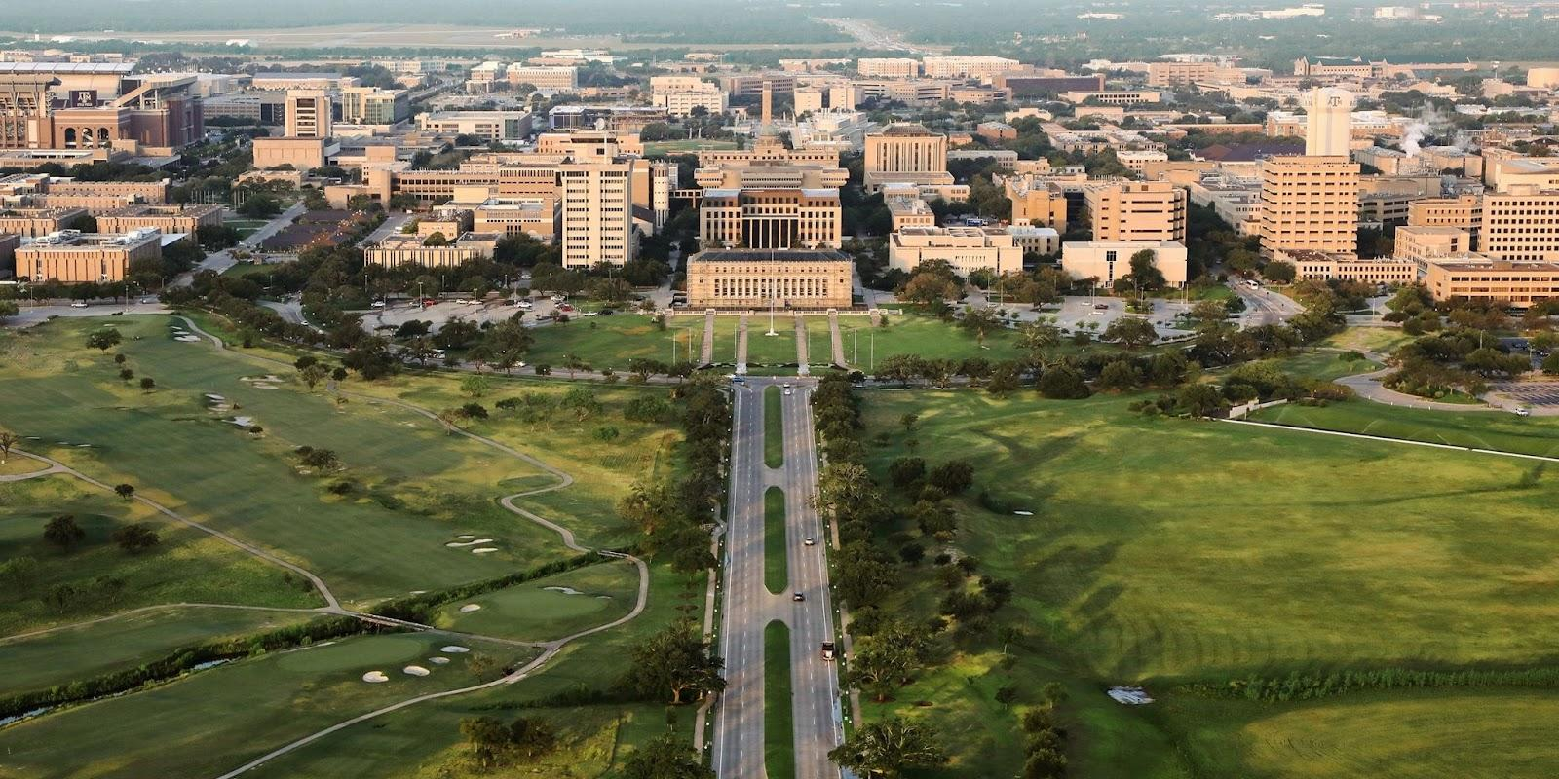

Informational
September 2nd, 2026
Notes:
James

Slide 2
Roles & Responsibilities
Shawn Archer – Pre-Professional School Advisor, Law & Pharmacy

Slide 3
Roles & Responsibilities
Advisor for Texas A&M Pre Law Society
Daily Availability
Assist Students Through Application Process
Stay Informed
  Law School Application Processes
  Financial Aid Environment
Confidence
Advocacy
Influence

Slide 4
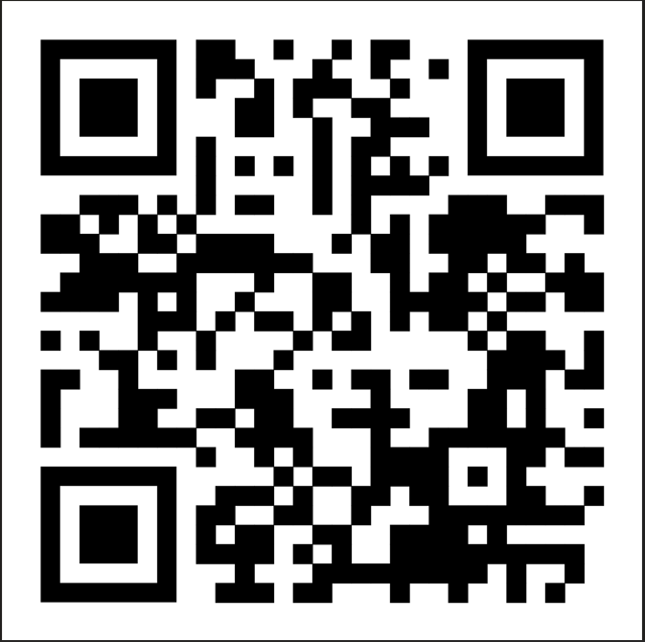
PRE LAW LISTSERV
SUBSCRIBE HERE

Slide 5
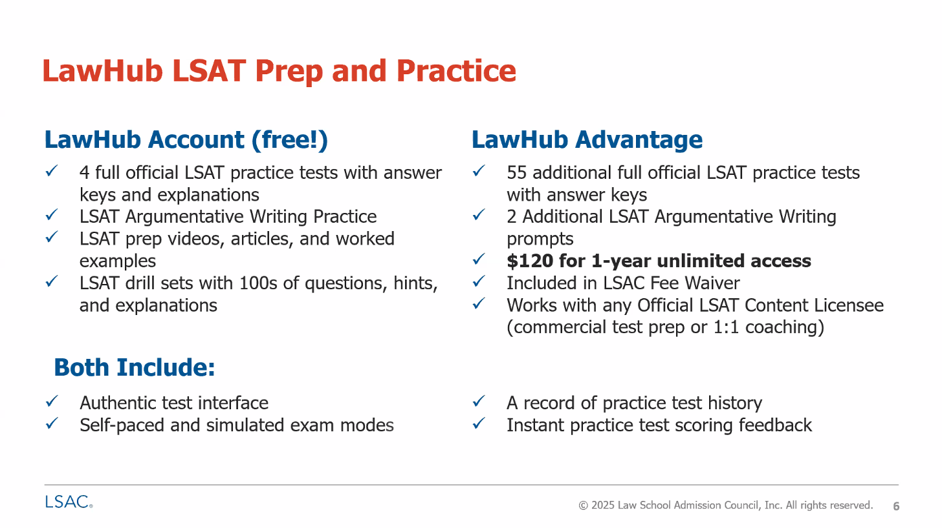

Slide 6
Thank You!

Slide 7
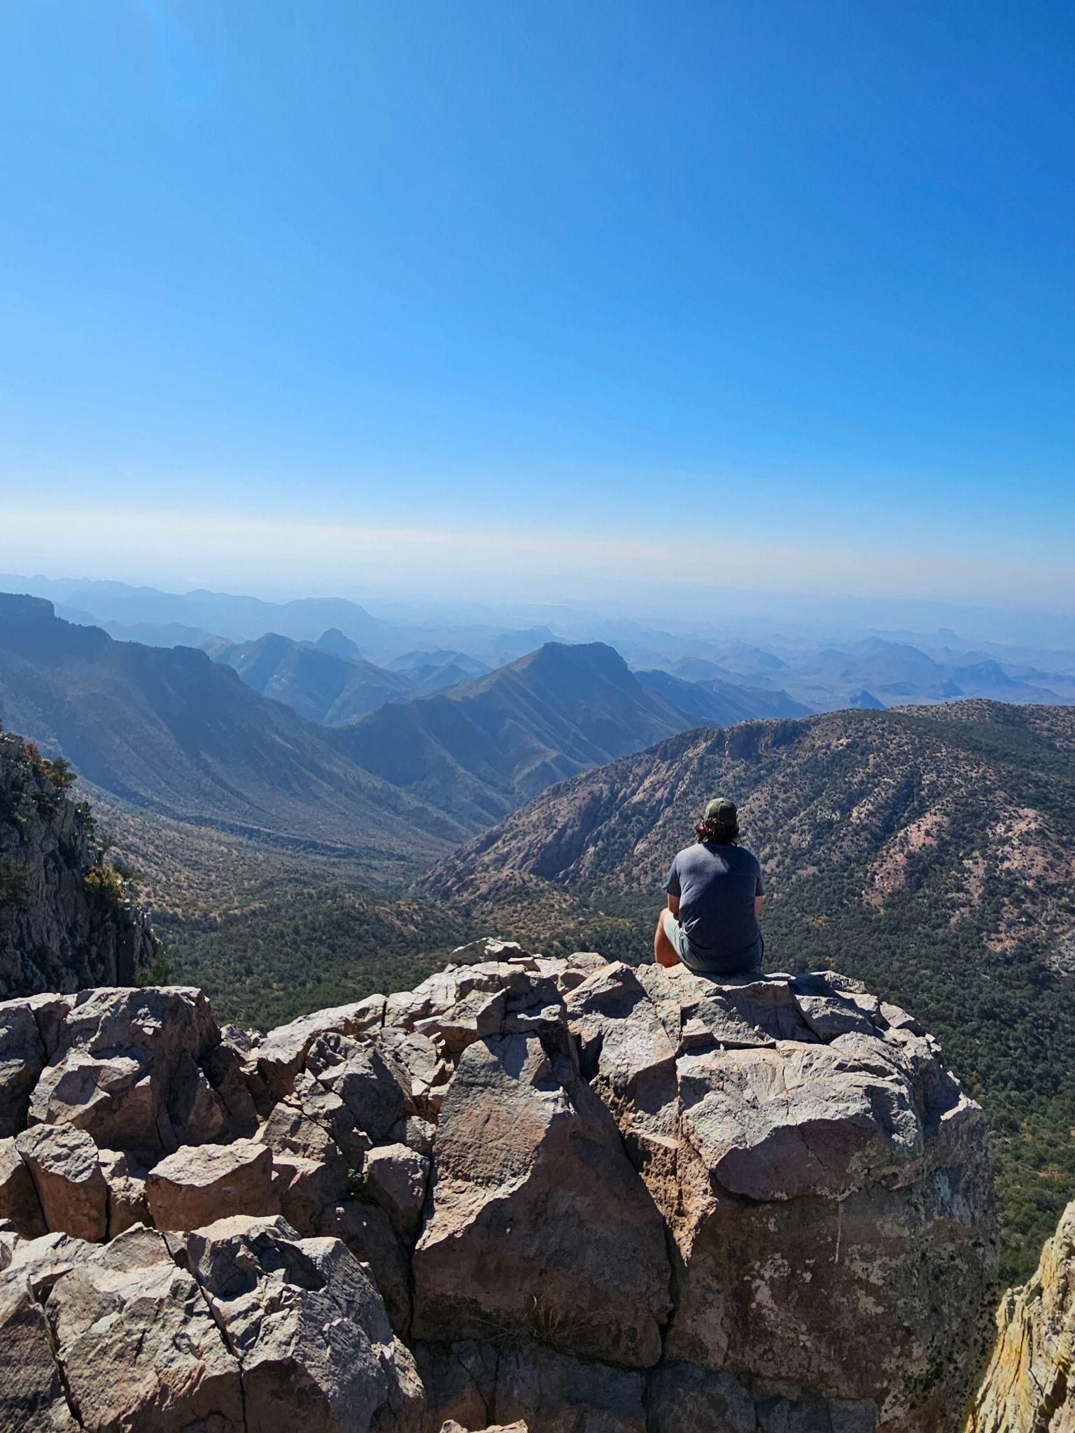
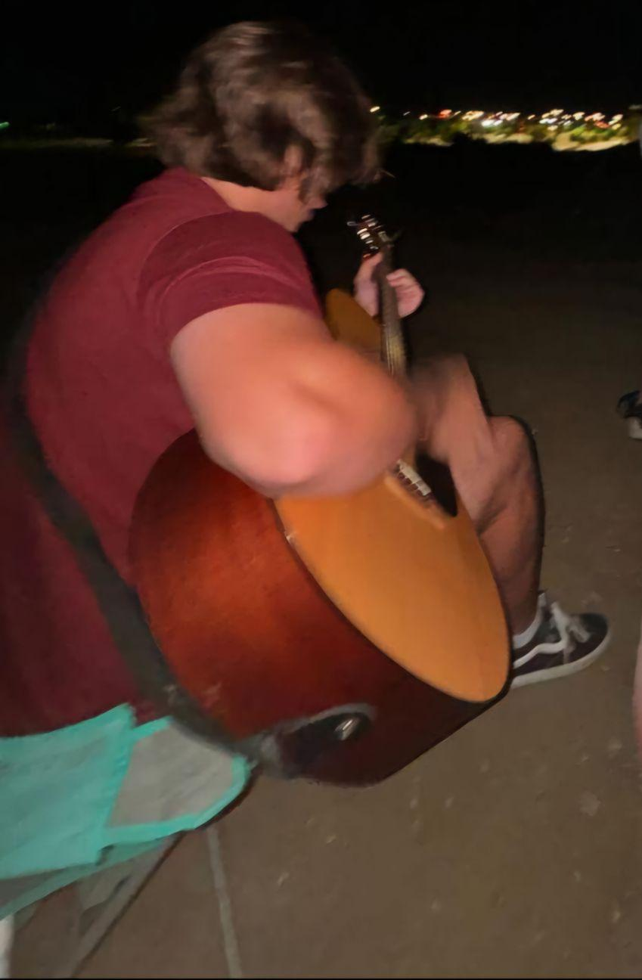
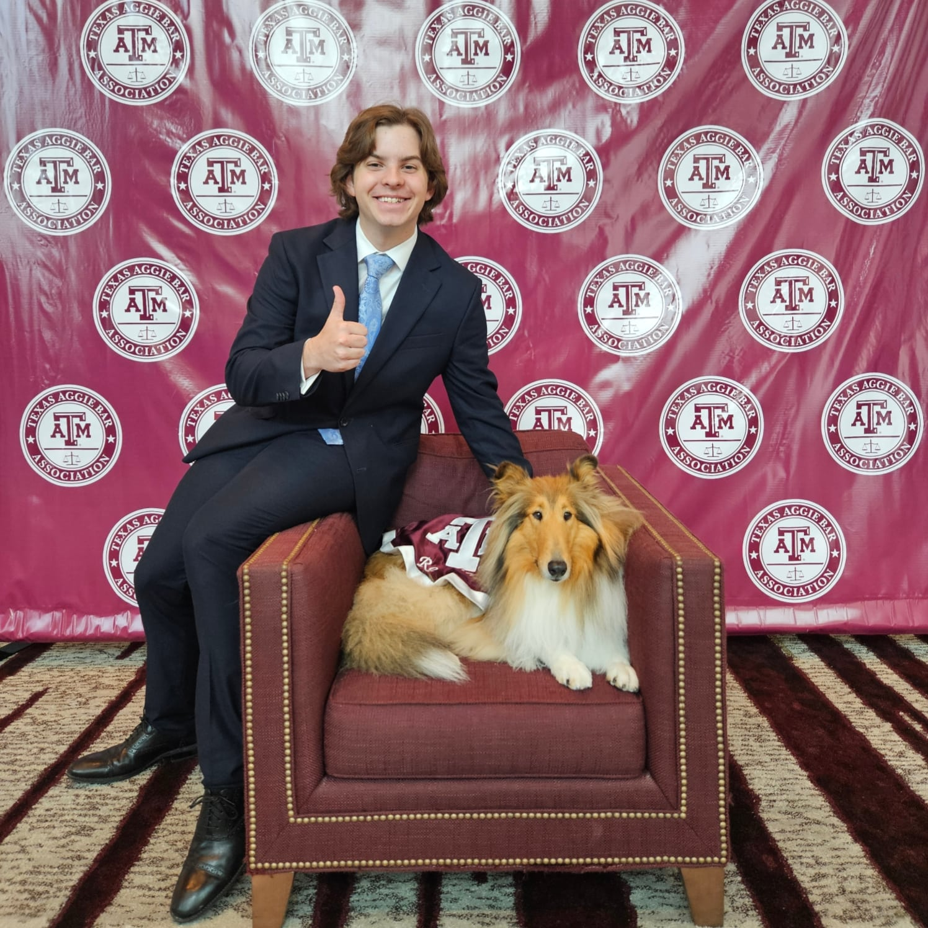
President - Will Mabe ‘27
Major: History w/ Minor in Philosophy
Hometown: Burleson, TX
Legal Field: Corporate Law
Interesting Facts:
  I had an FBI Security Clearance
  I am a huge fan of 60s/70s rock music (I can talk about the Beatles or
Led Zeppelin for hours)
  My hobbies include: playing guitar, collecting vinyl records, and reading

Slide 8
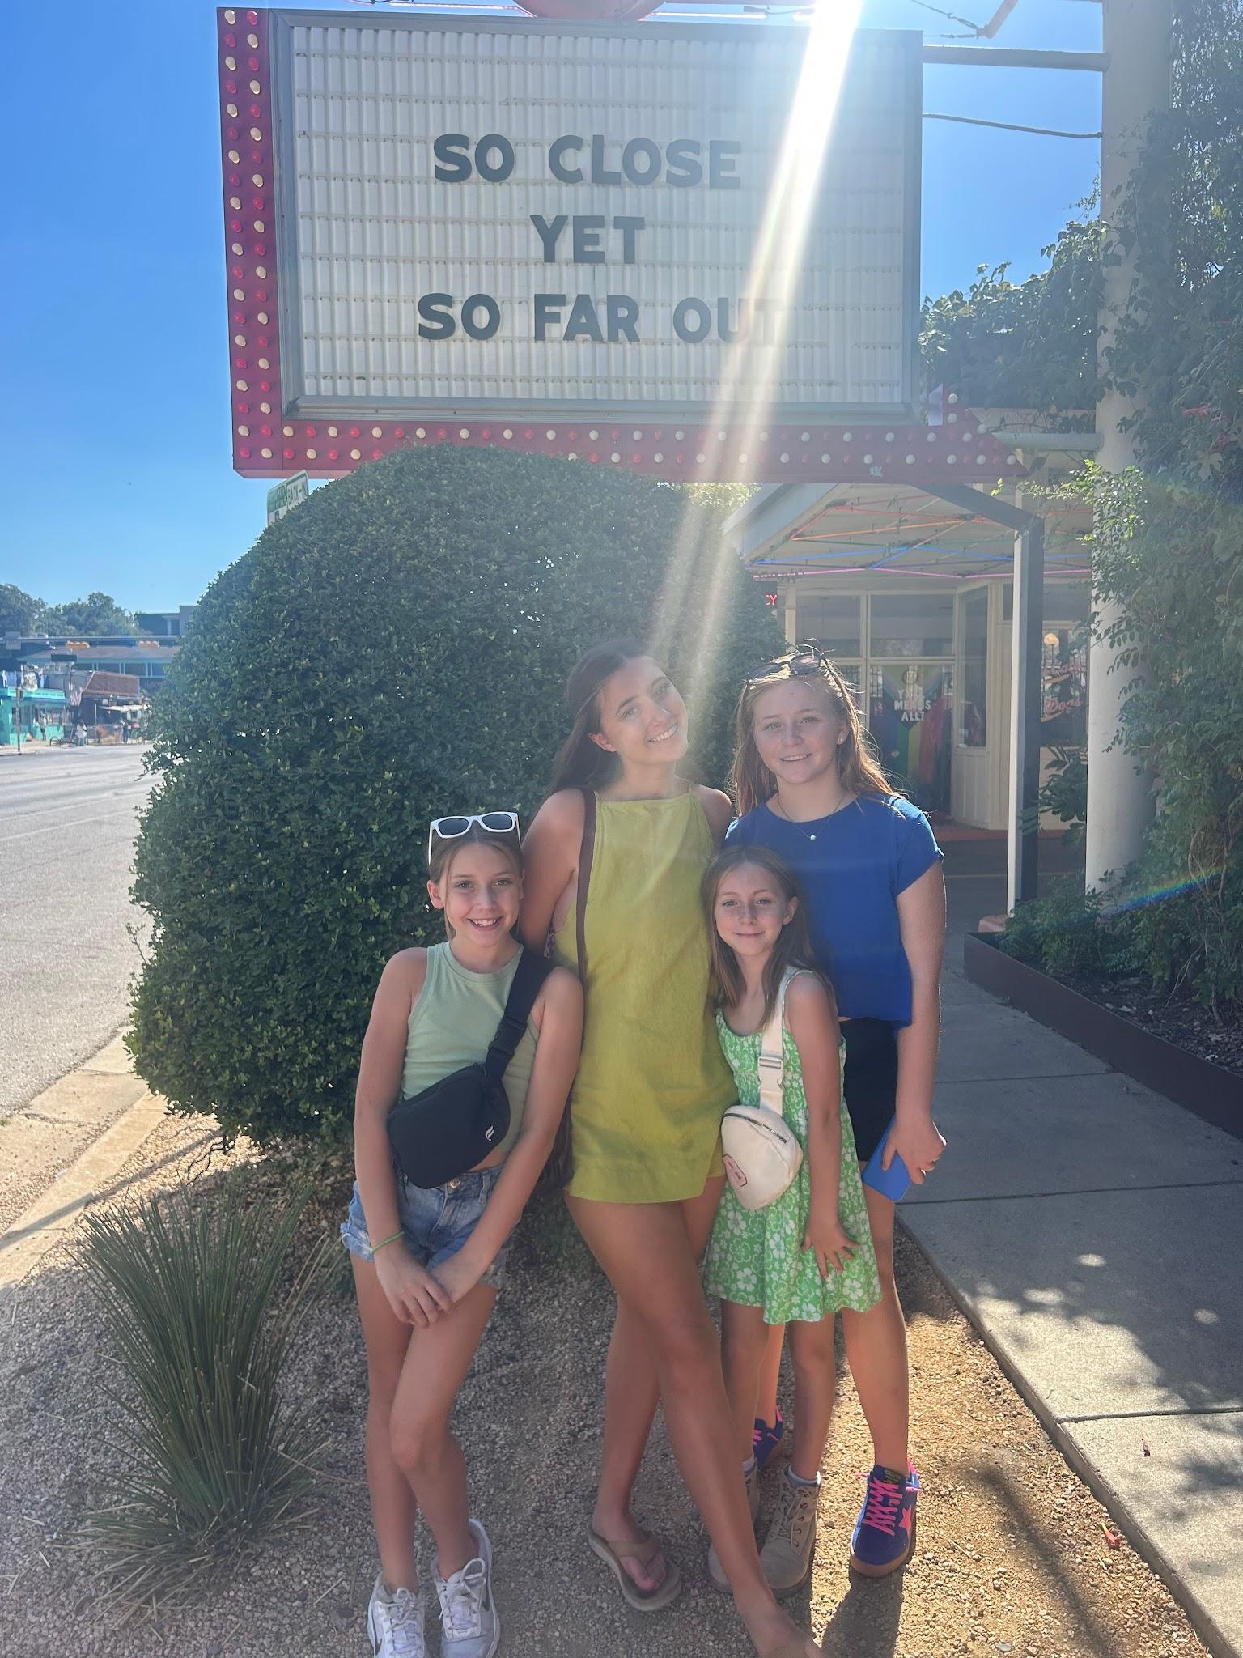
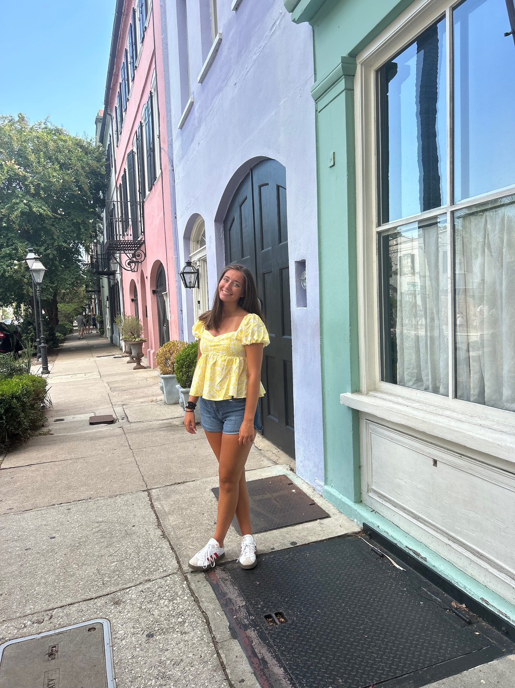
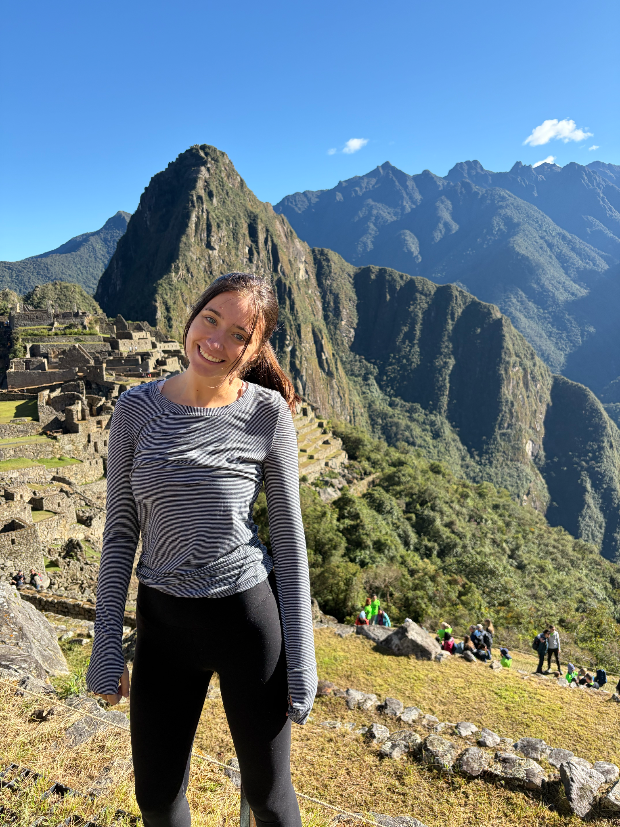
Vice President - Cayden Cherne ‘26
Major: Business Management Pre Law w/ Minor in Military Studies
Hometown: Georgetown, TX
Legal Field: International Law
Interesting Facts:
  Oldest of 4 girls!
  I’ve been to 36 countries, love traveling
  I was born and raised in Chicago

Slide 9
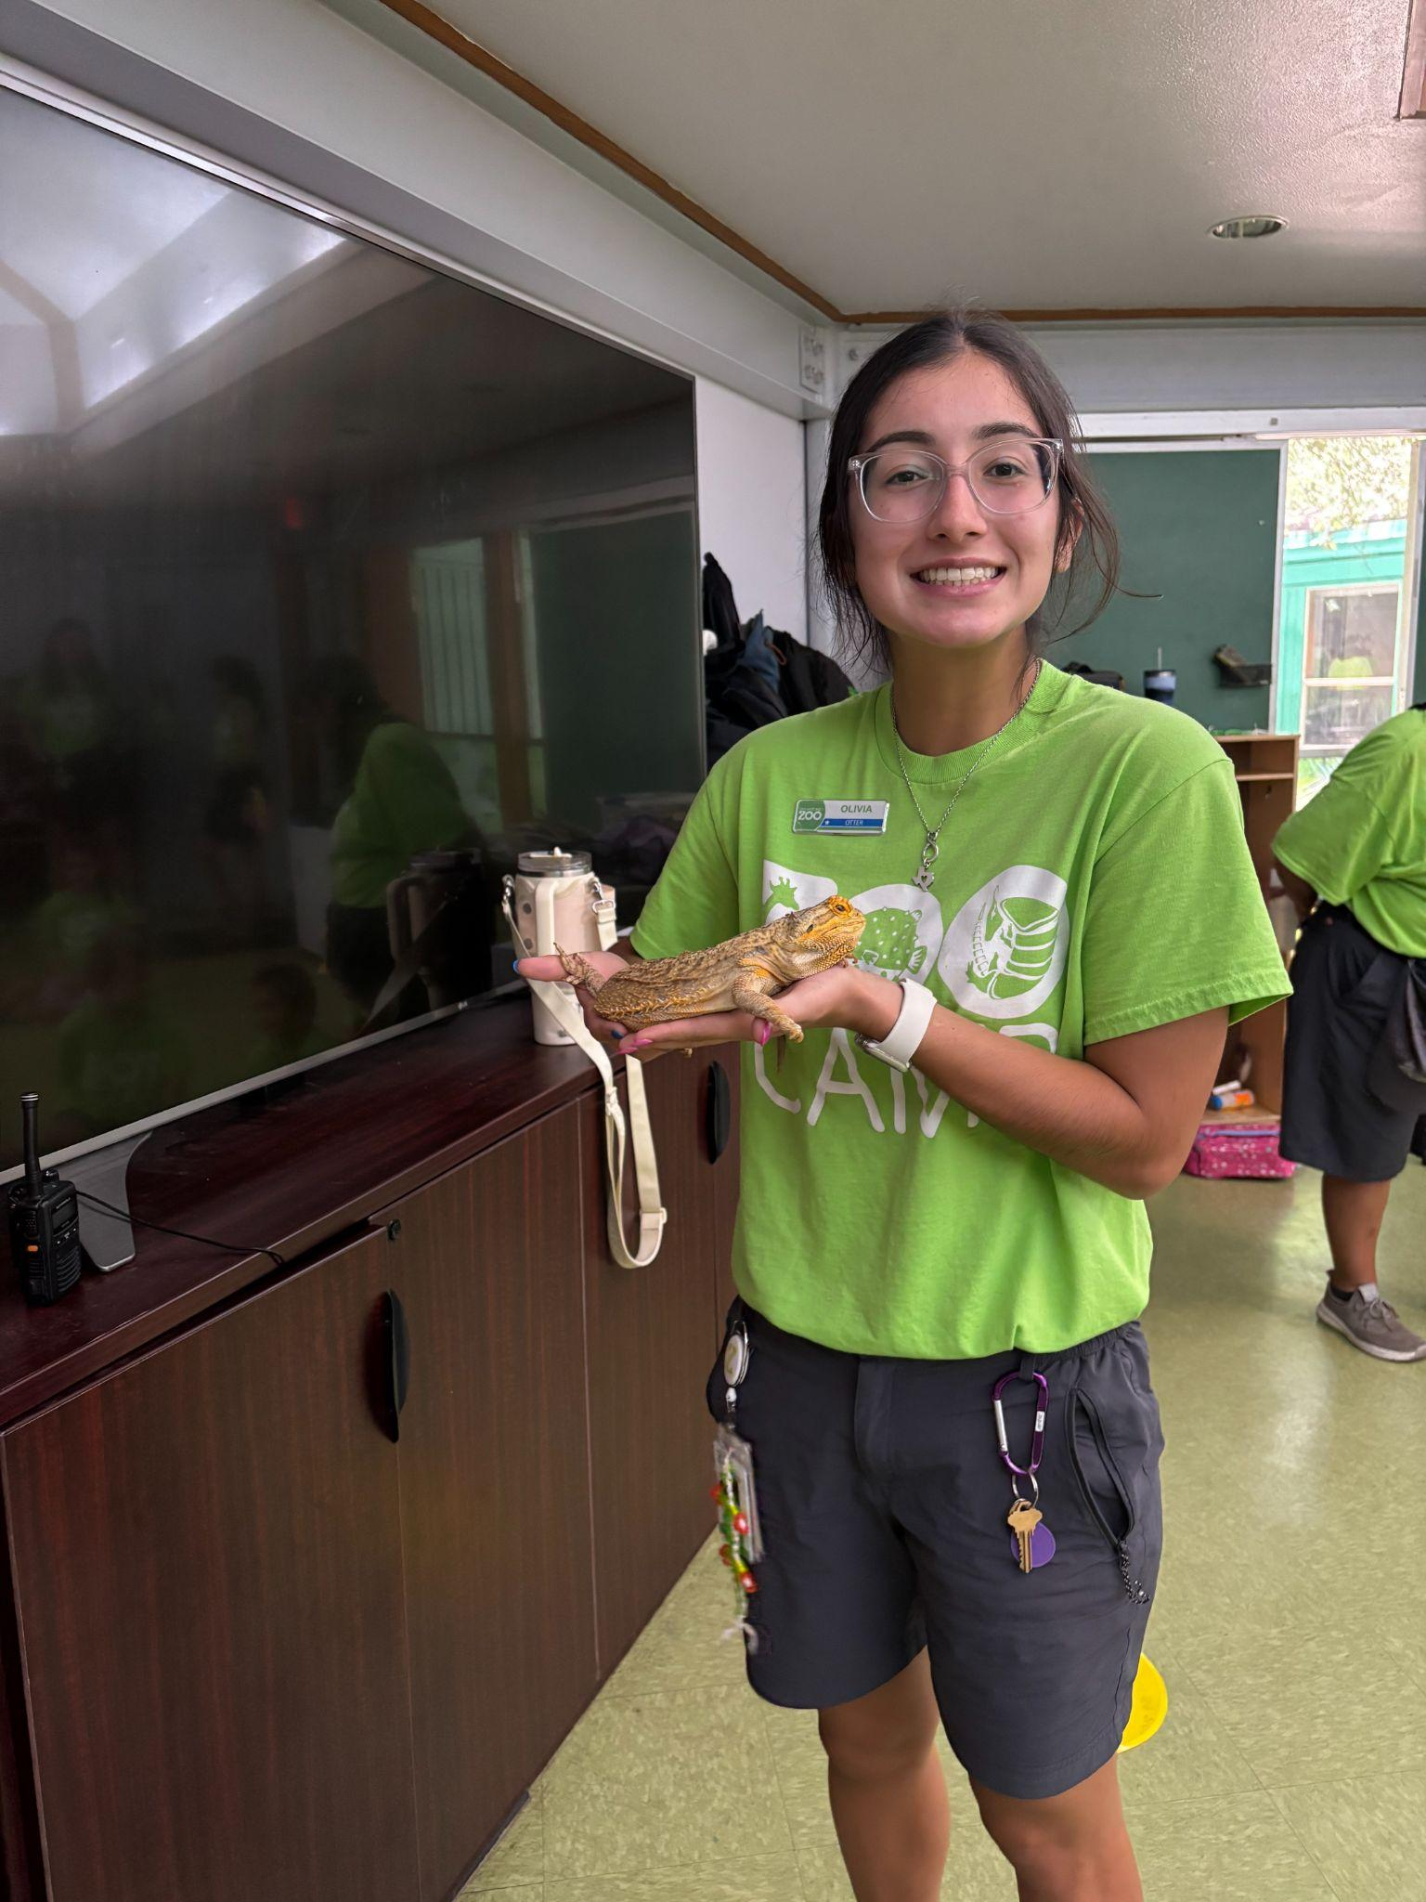
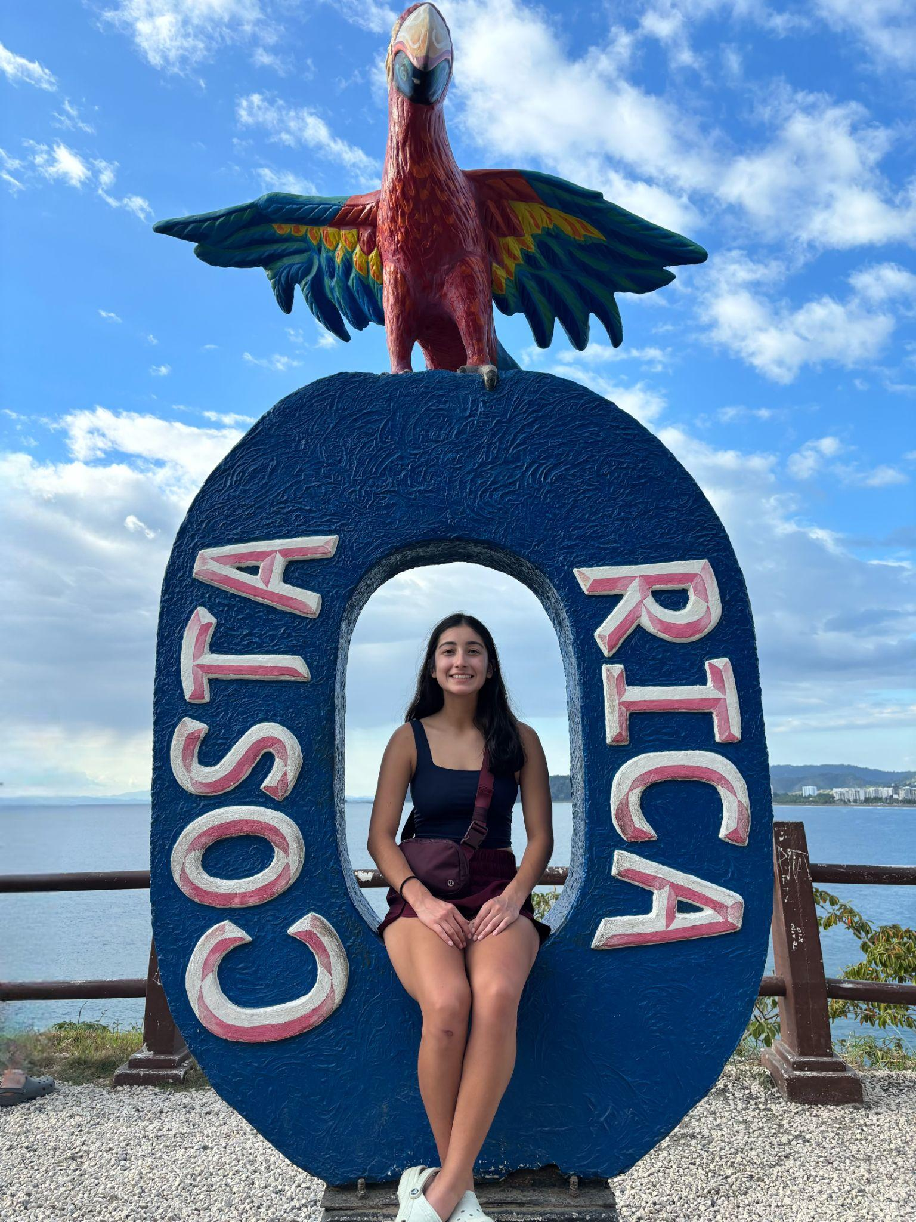
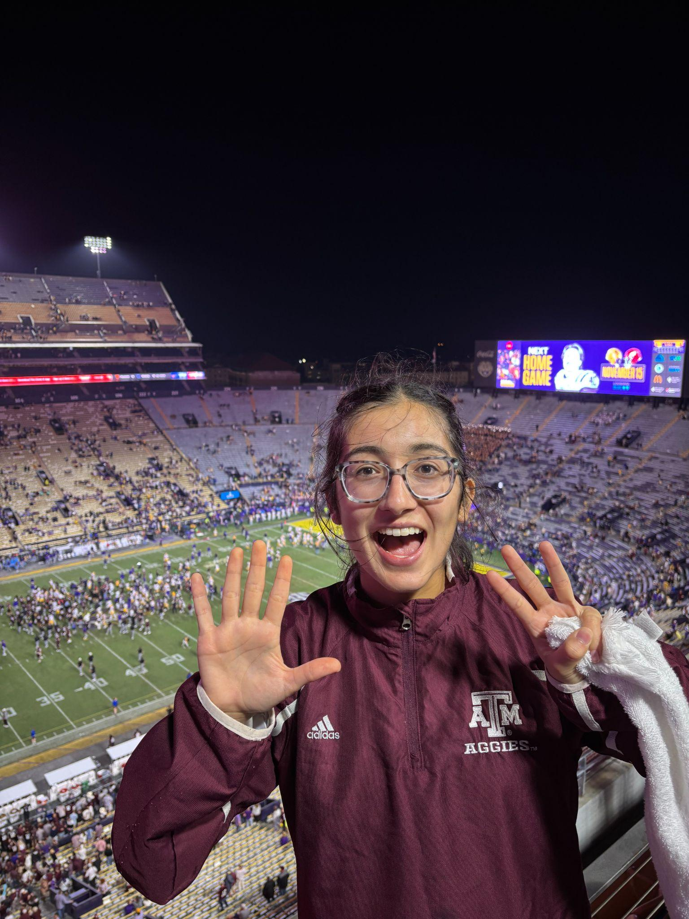
Treasurer - Olivia Skaggs ‘27
Major: Business Administration in Business Honors; Supply Chain Management
Hometown: La Vernia, TX
Legal Field: Corporate or Nonprofit Law
Interesting Facts:
  I was born in Michigan (family moved to Texas soon after)
  Recently traveled abroad for the first time
  10-year age gap with my younger brother

Slide 10
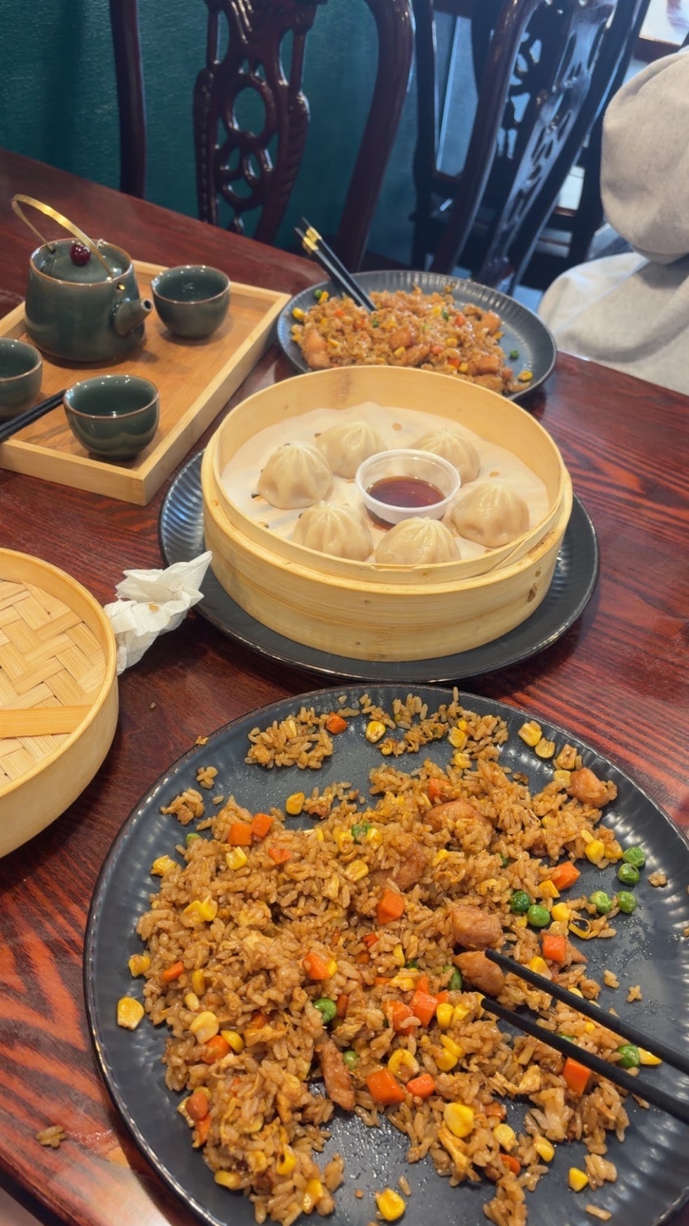
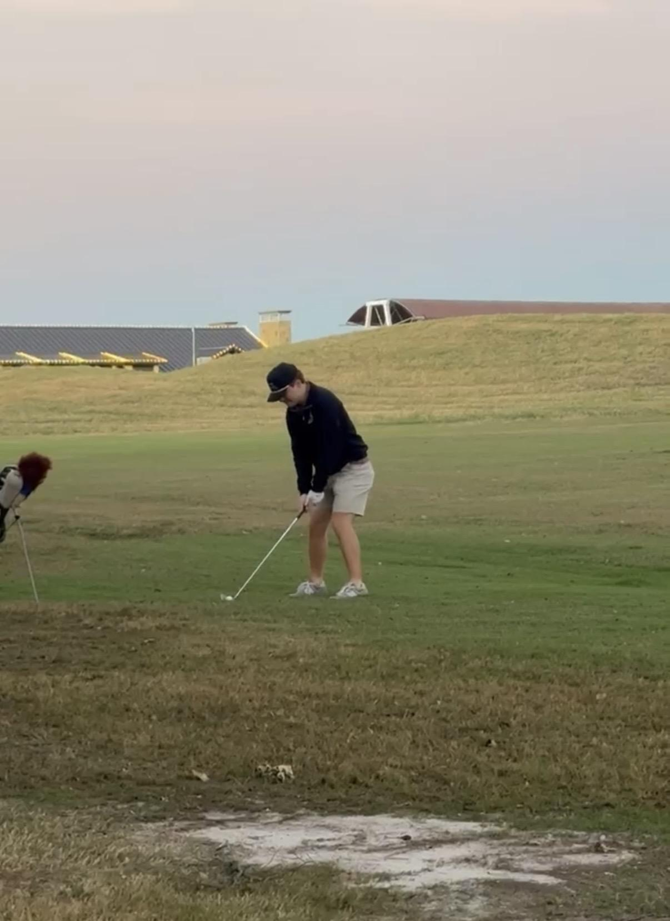
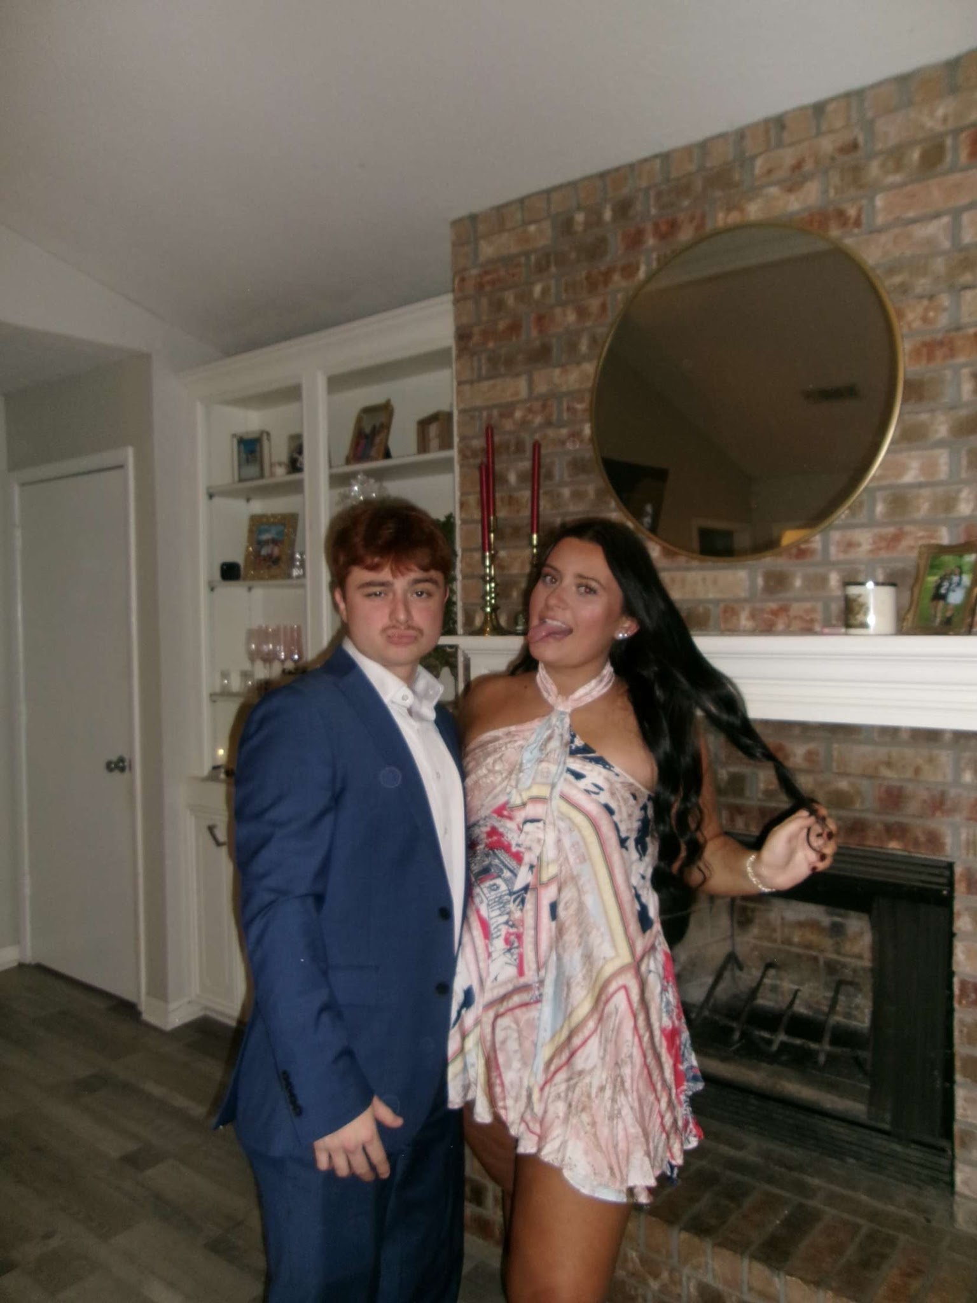
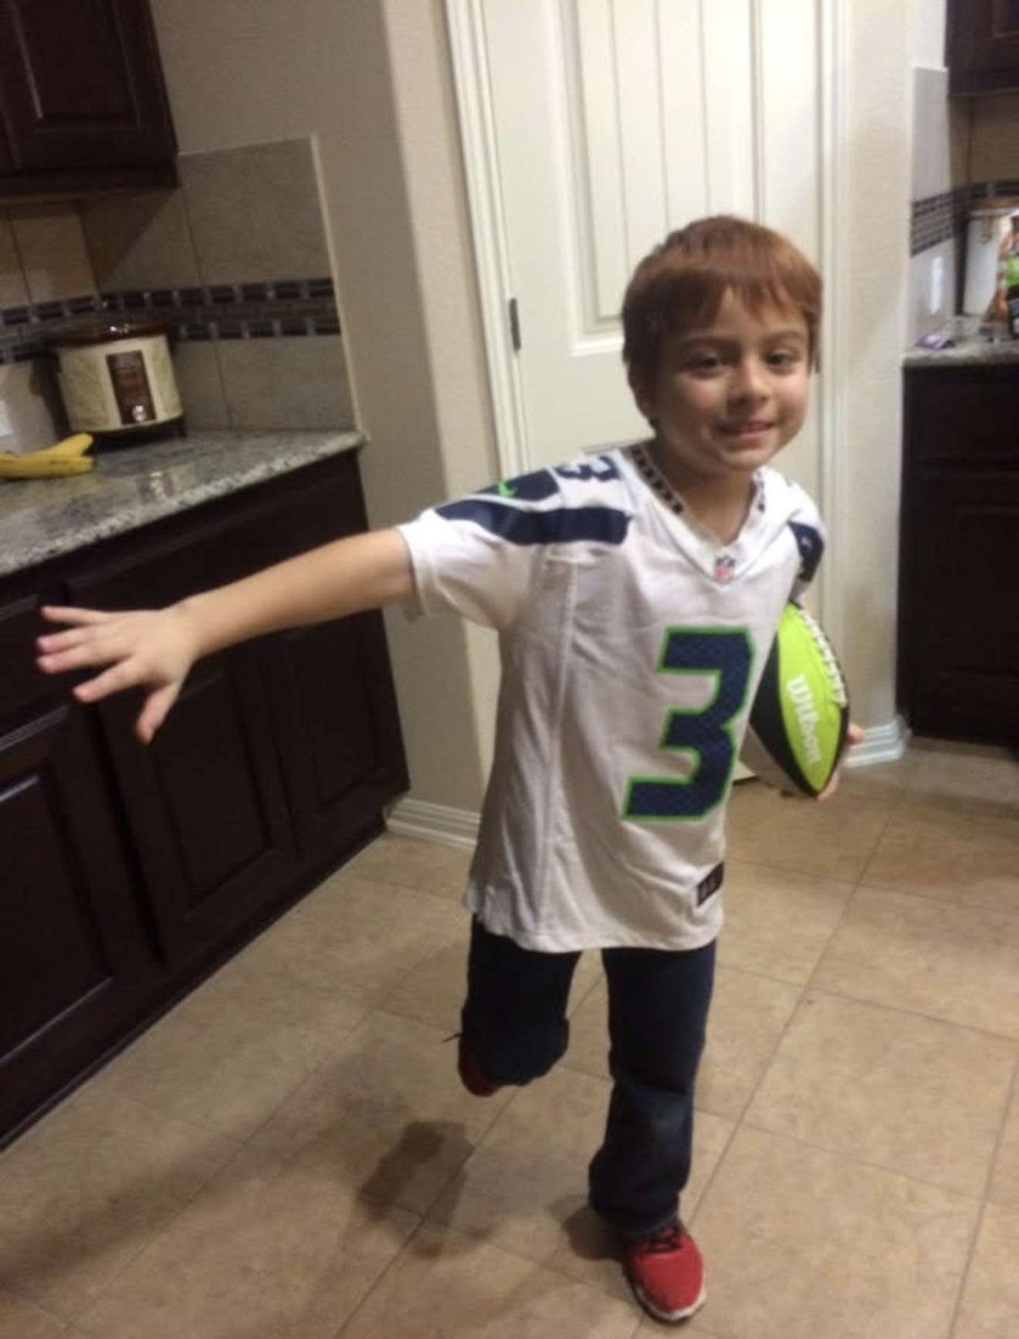
Director of Development - Zebian Escobedo ‘27
Major: Business Management - Pre Law
Hometown: Waco, TX
Legal Field: Corporate Law
Interesting Facts:
  I’m into golf and also play guitar
  I love dim sum
  My favorite NFL team is the Seattle Seahawks

Slide 11
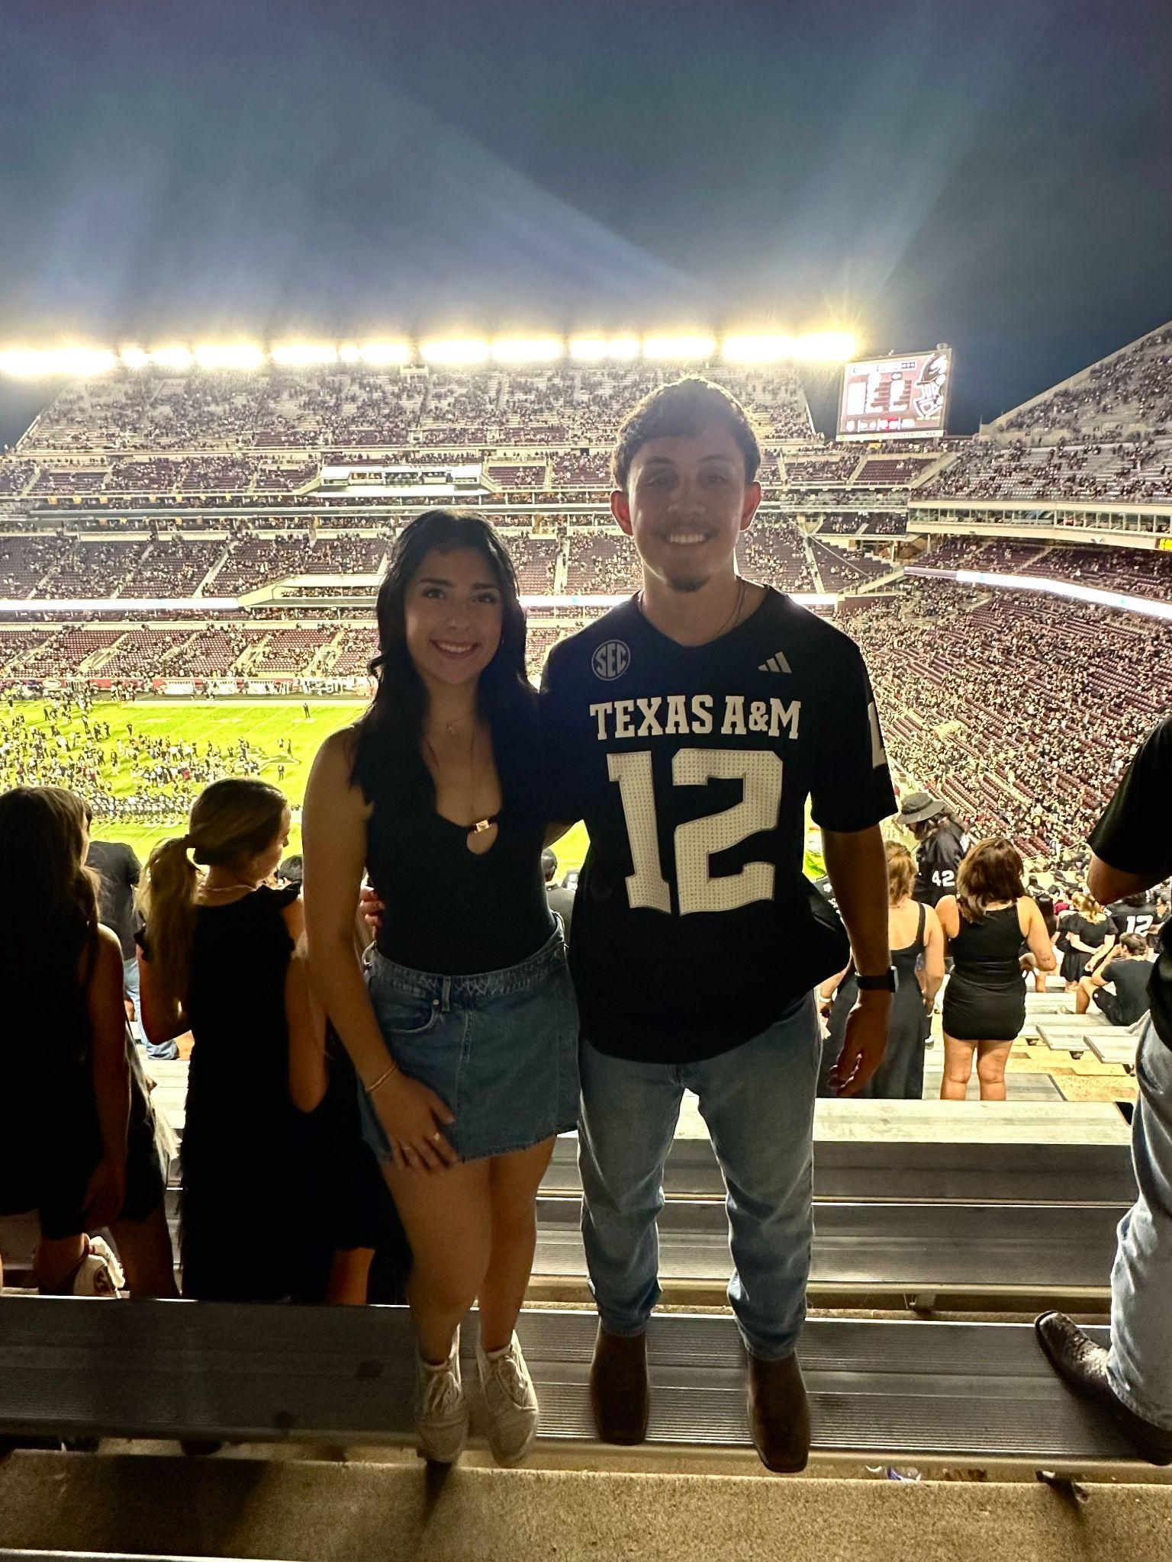
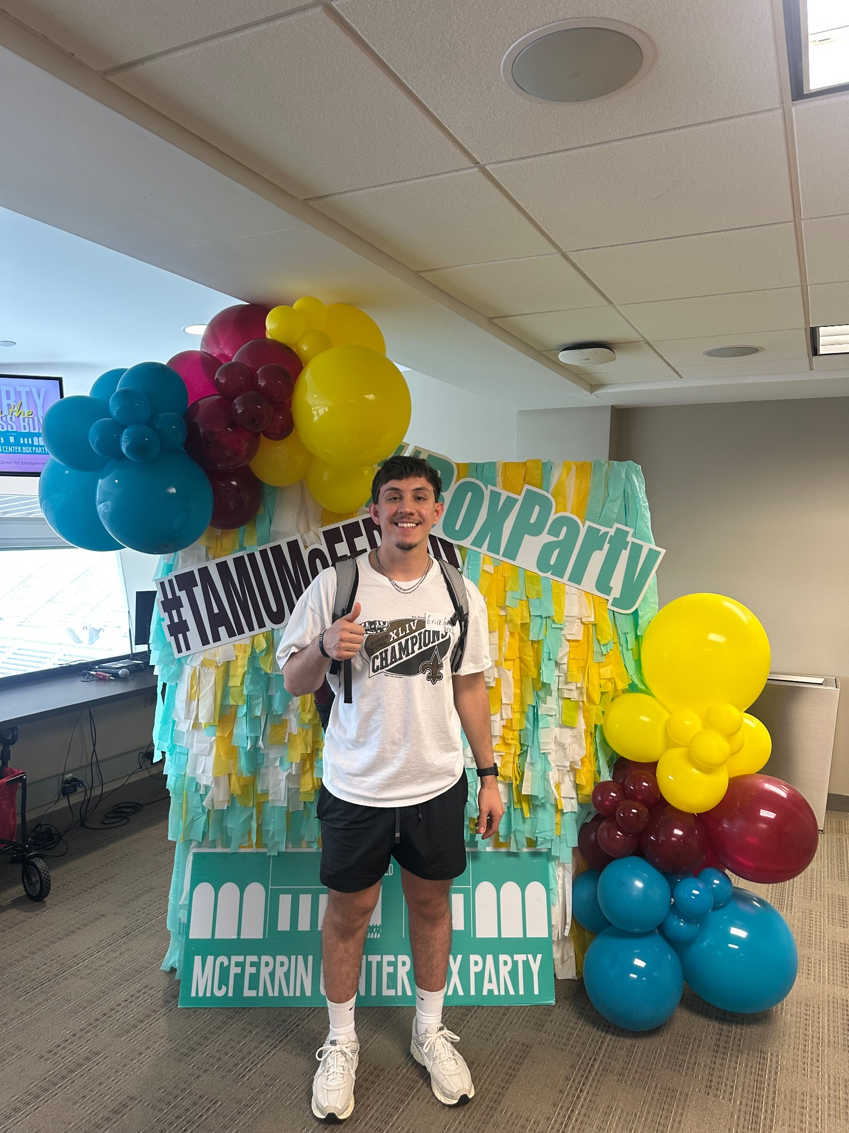
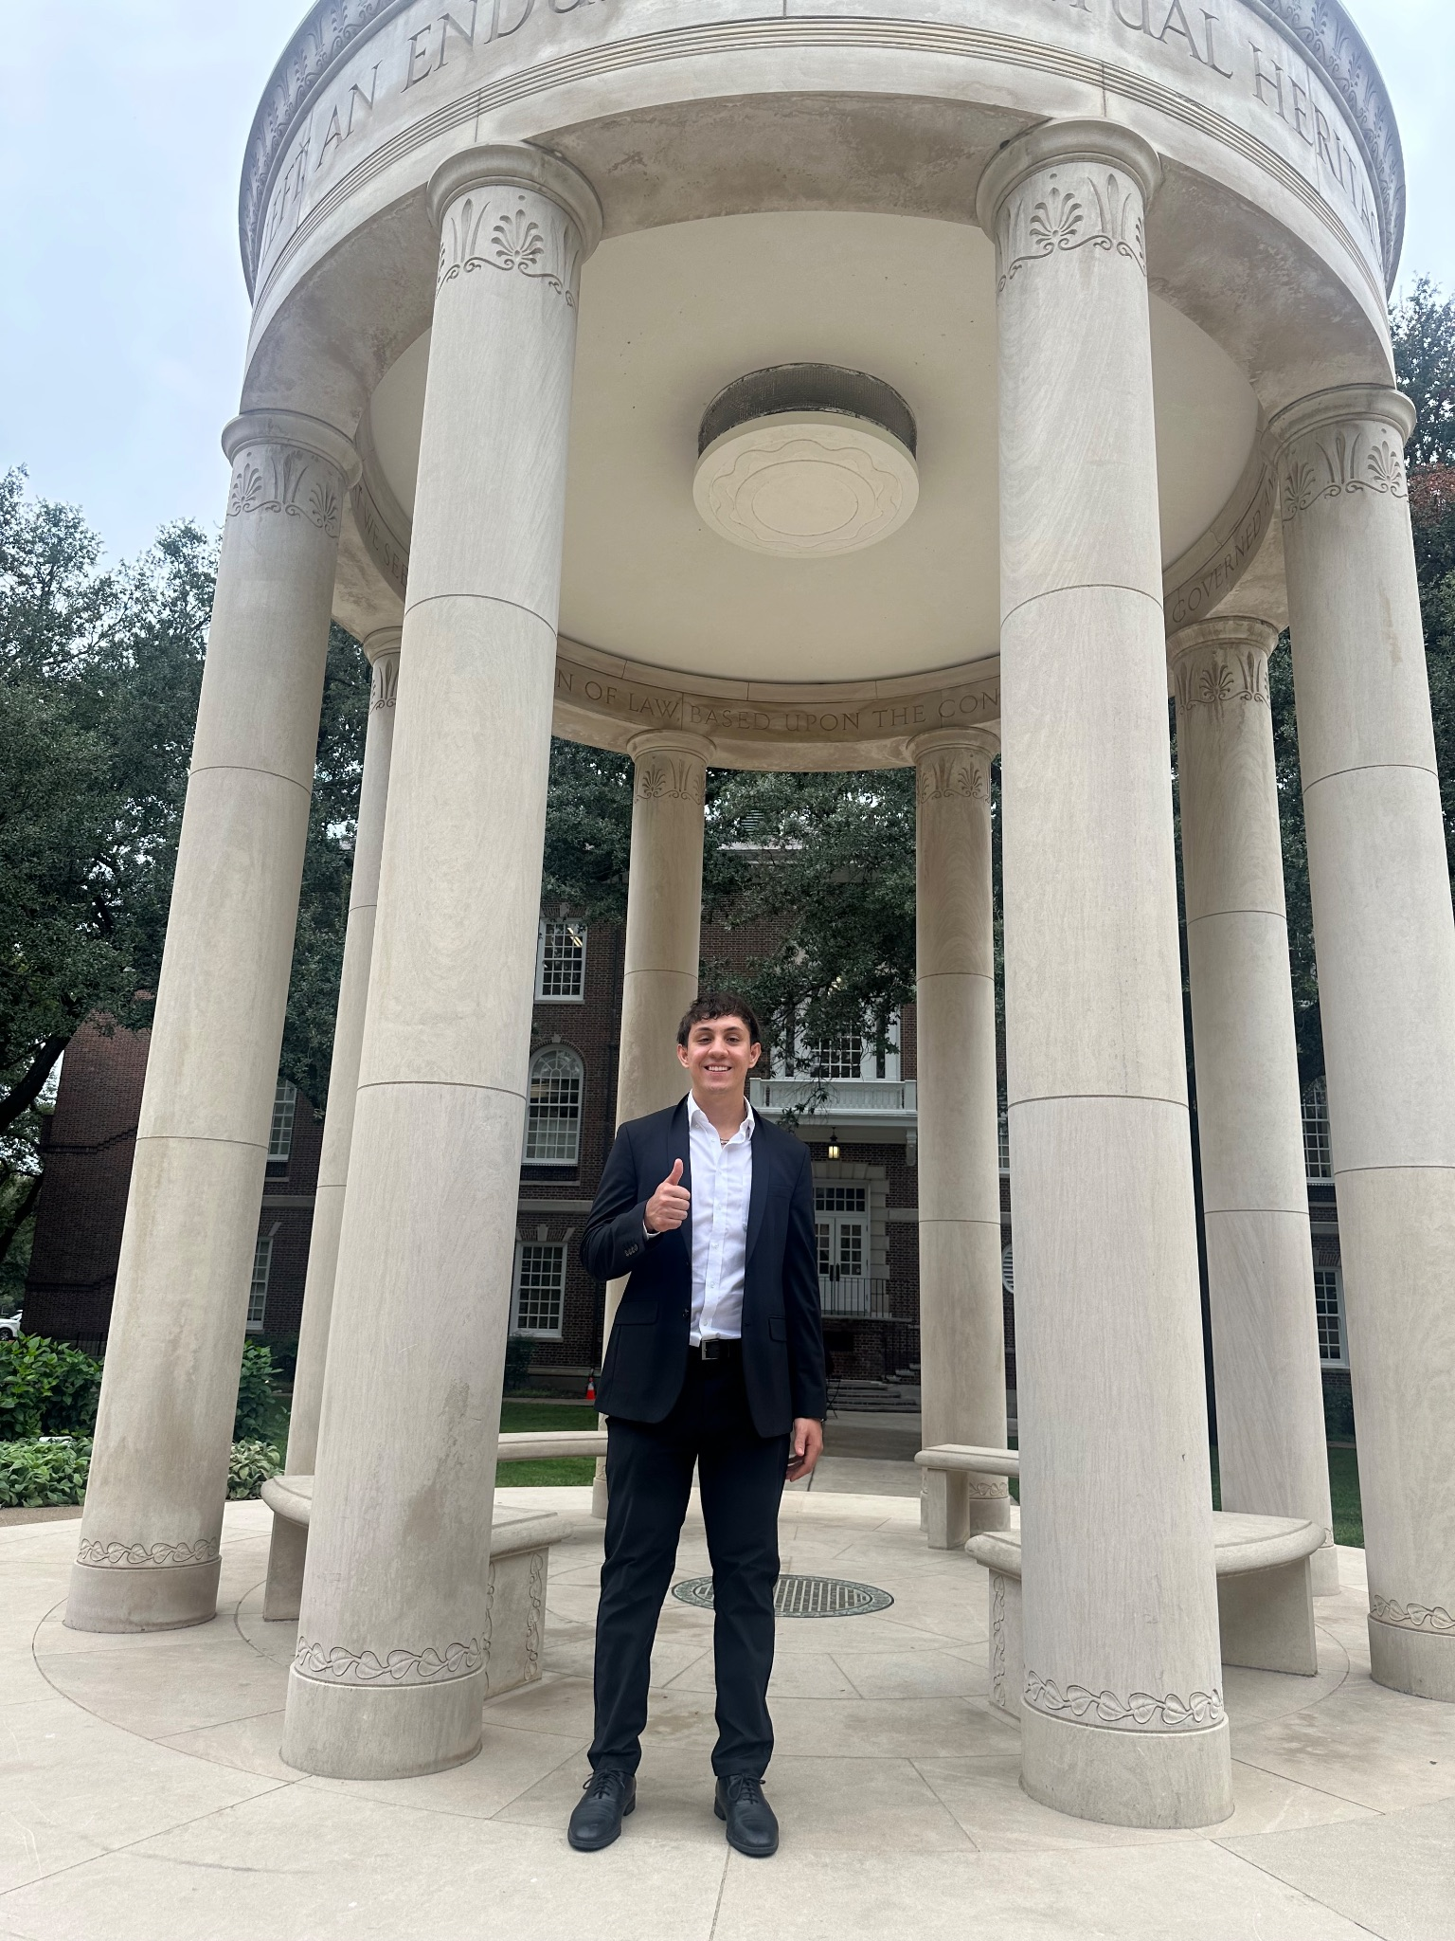
Director of Administration - Erick Garcia ‘26
Major: Society, Ethics, and Law, Minors in Philosophy & Business with a Philosophy Pre-Law Certificate
Hometown: Edinburg, TX
Legal Field: Corporate or Criminal Law
Interesting Facts:
◦ Love to cook and try new recipes
◦ I’ve traveled to 10+ states
◦ I love to workout and play basketball
◦ I am bilingual

Slide 12
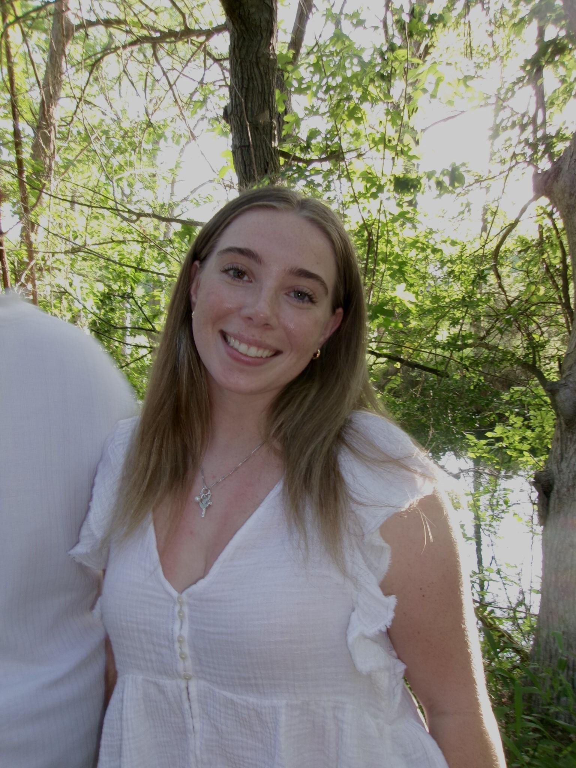
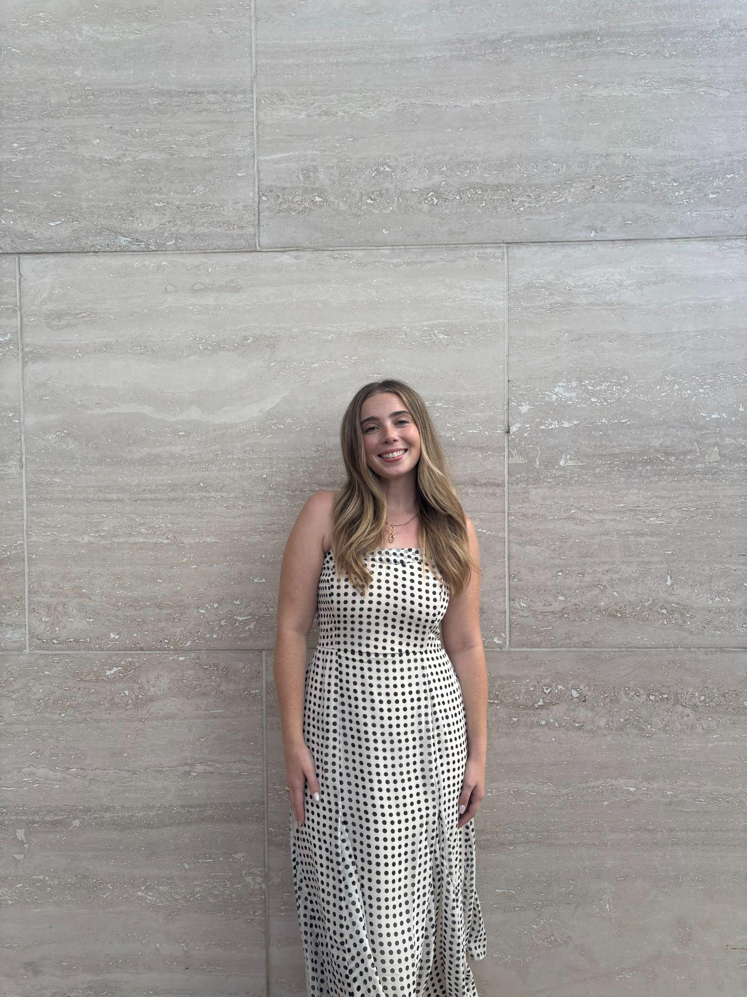
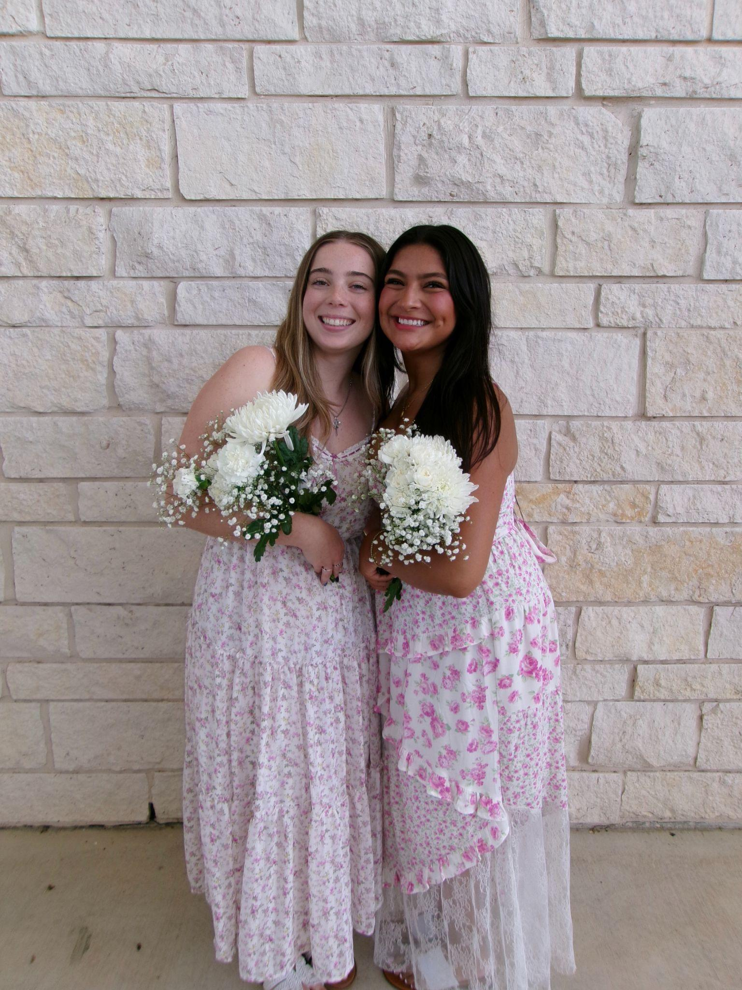
Director of Social - Chloe Barrientes ‘27
Major: Business Management Pre Law, Minor in Sport Management
Hometown: Houston, Texas
Legal Field: Corporate Law
Interesting Facts:
  I have two different colored eyes.
  I love to workout and be active.
  My goal is to go to more concerts!

Slide 13
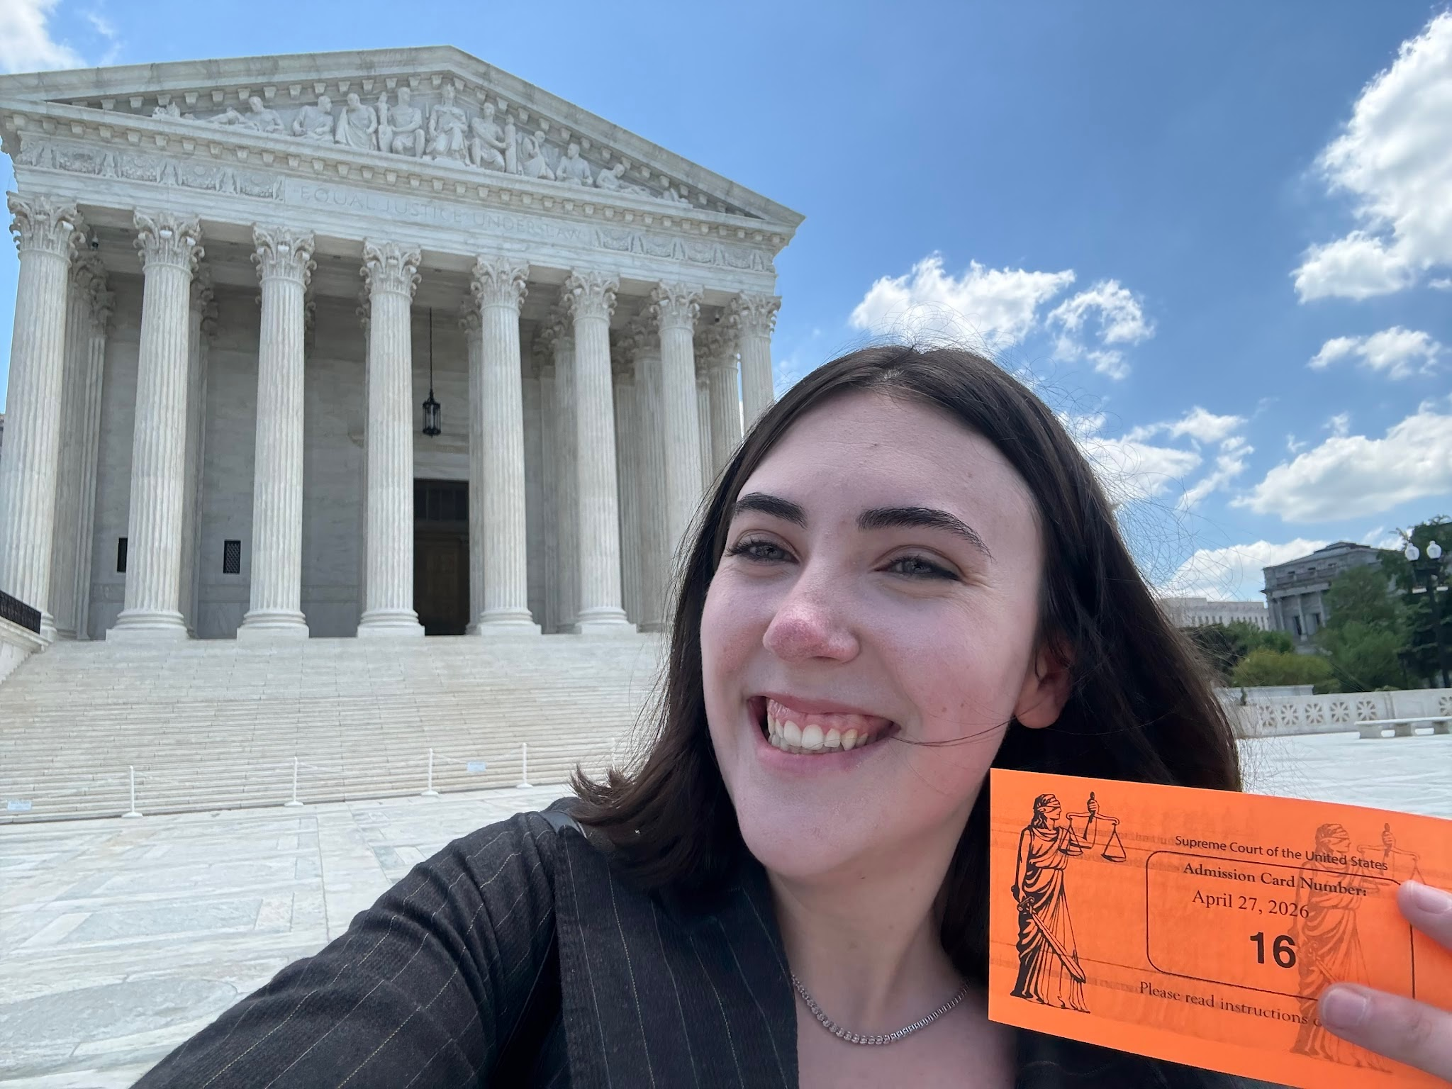
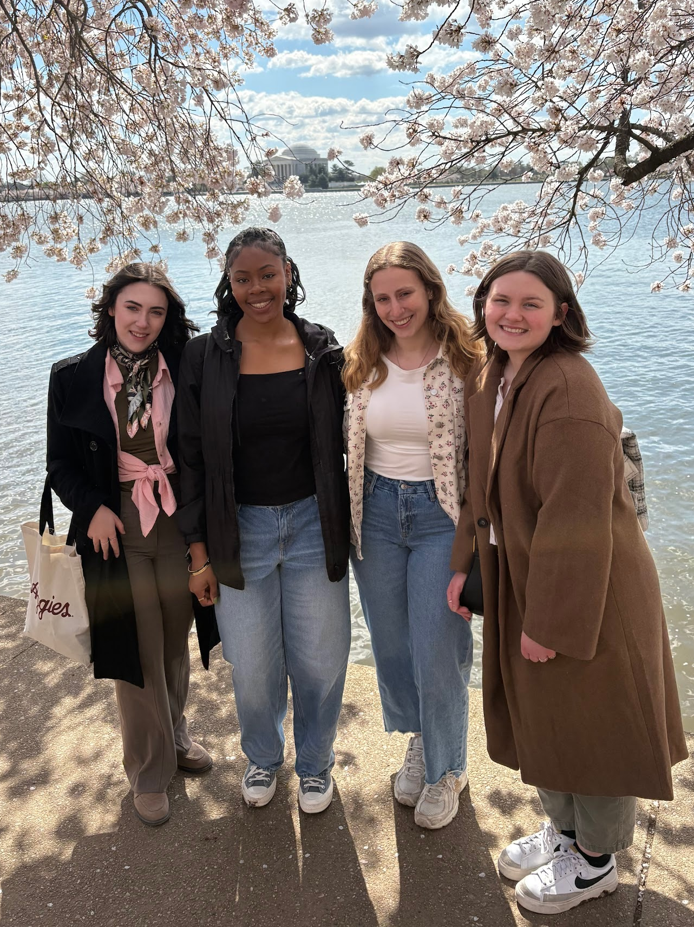
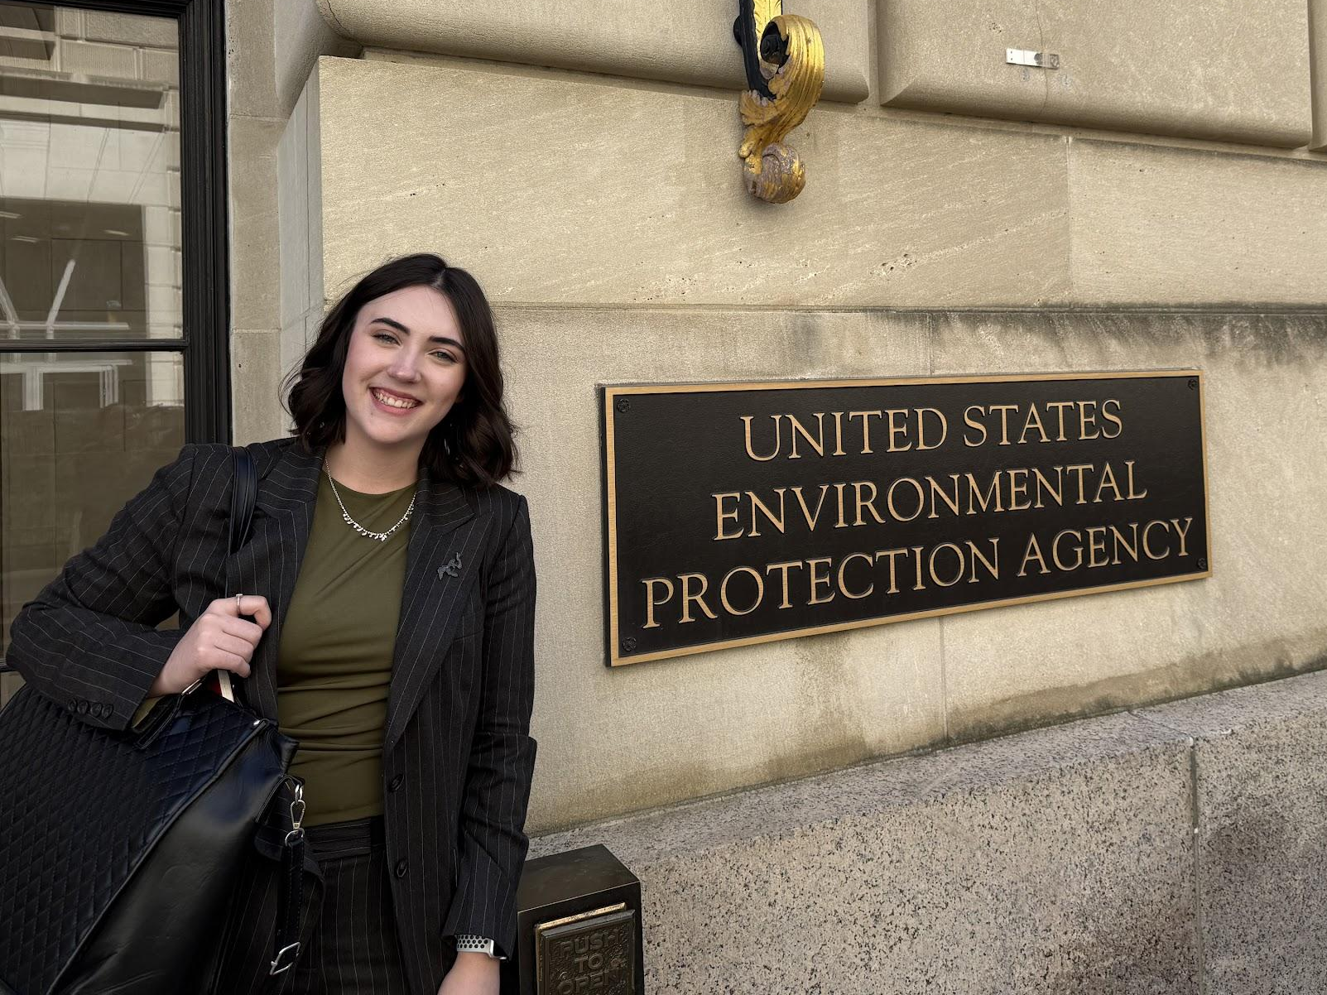
Director of Service - Taylor deNeve
Major: Society, Ethics, & Law
Hometown: Belton, TX
Legal Field: Environmental or Toxic Tort
Interesting Facts:
  Heard SCOTUS Monsanto v. Durnell
  I play Polo
  Concert enthusiast (5SOS, Niall Horan,
The Weeknd, Saint Motel, Franz Ferdinand)

Slide 14
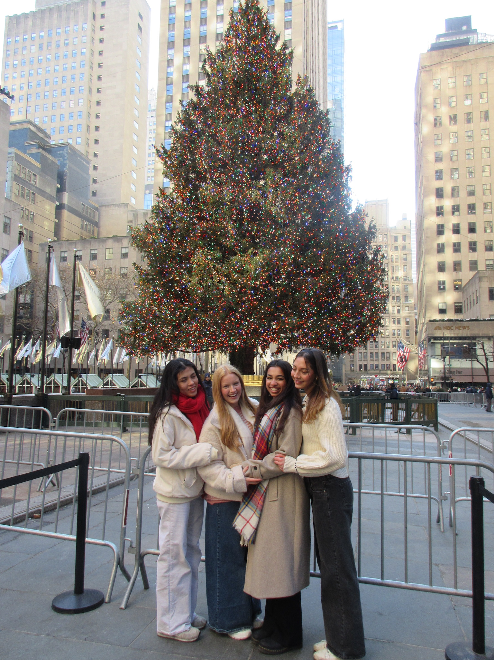
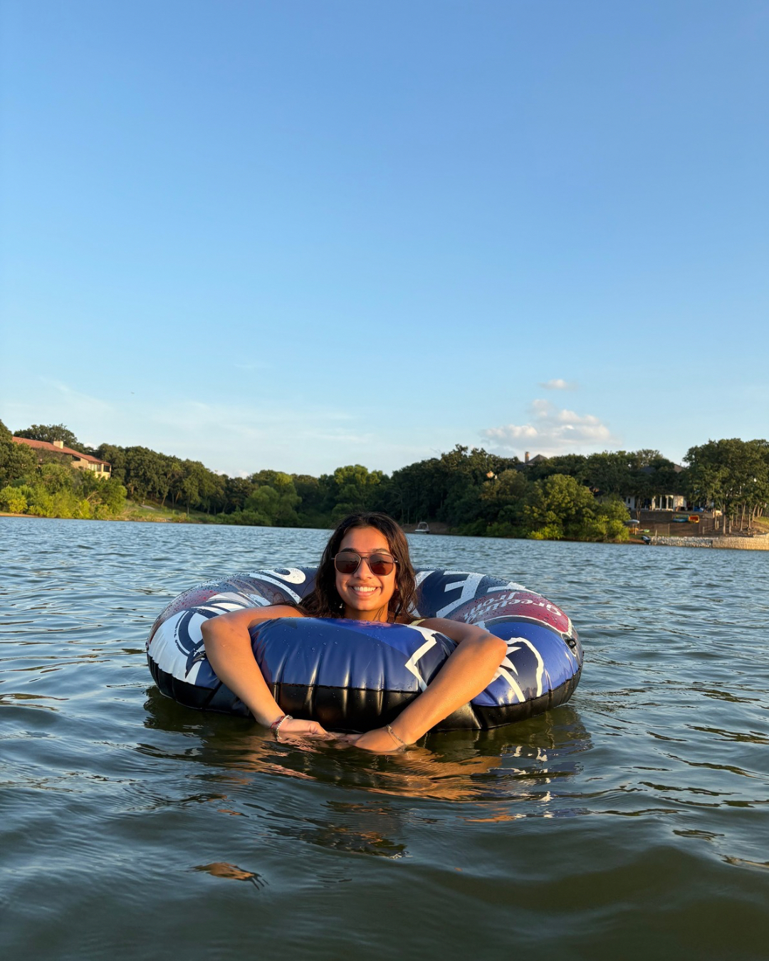
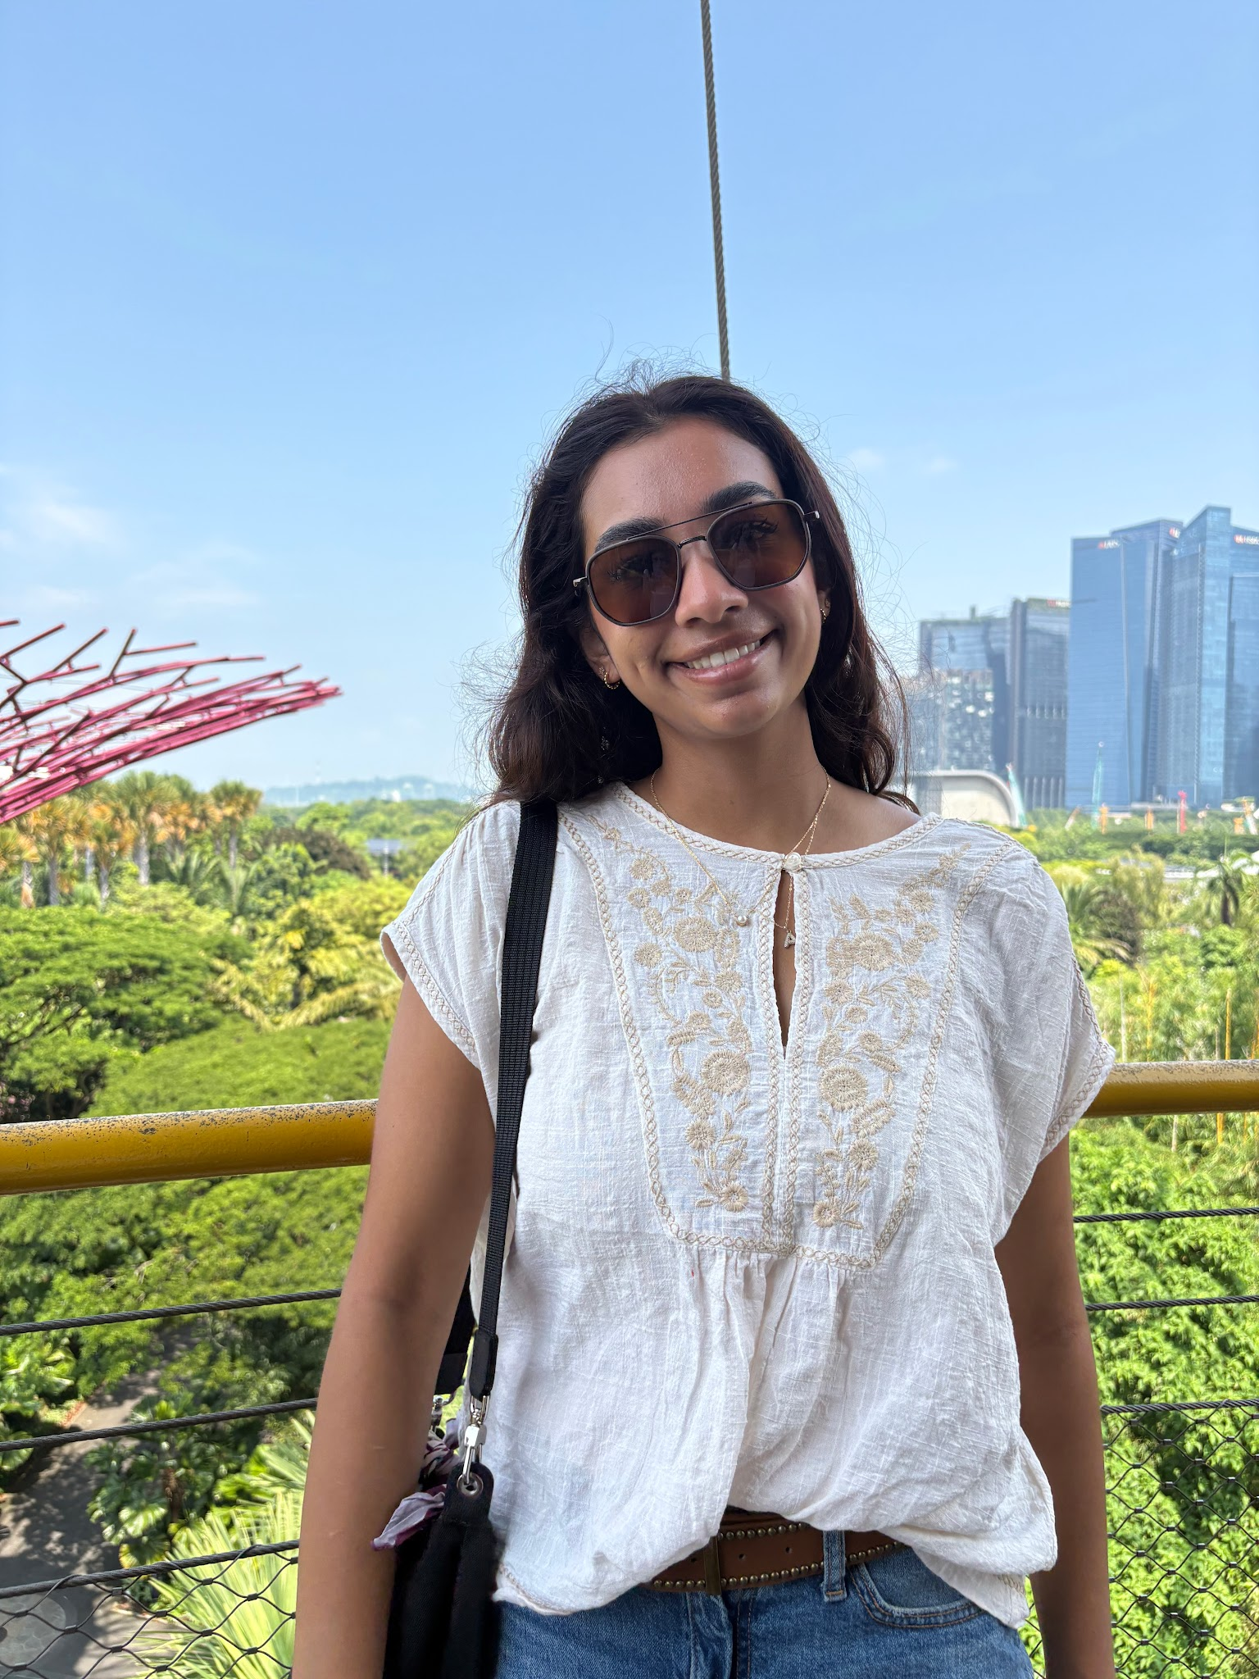
Director of Outreach - Anika Reddy
Major: MIS
Hometown: Dallas, Texas
Legal Field: Corporate or Family Law
Interesting Facts:
  Great at card tricks
  Like being outdoors and hiking
  I love to Travel, my favorite place was Peru

Slide 15
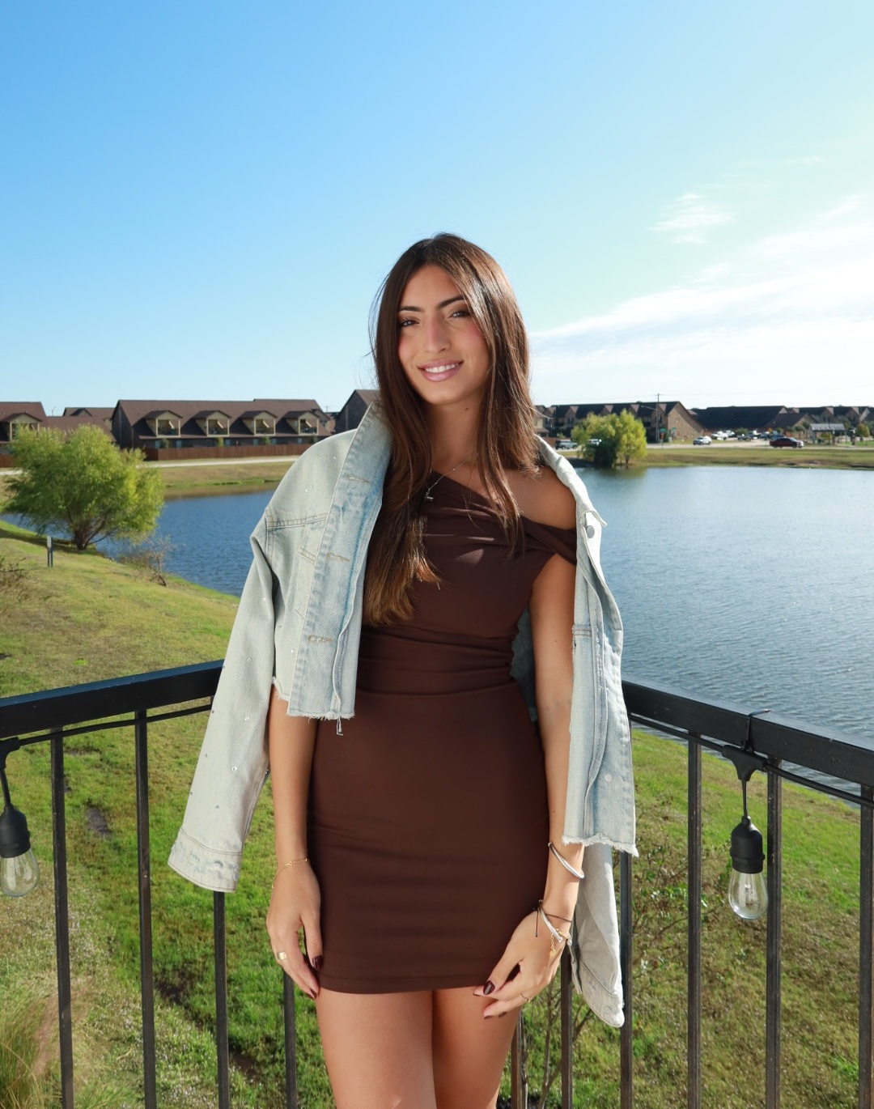
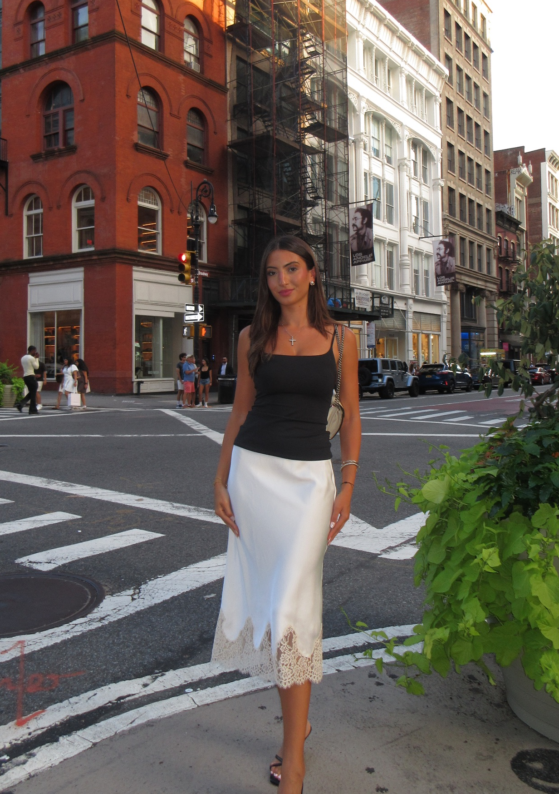
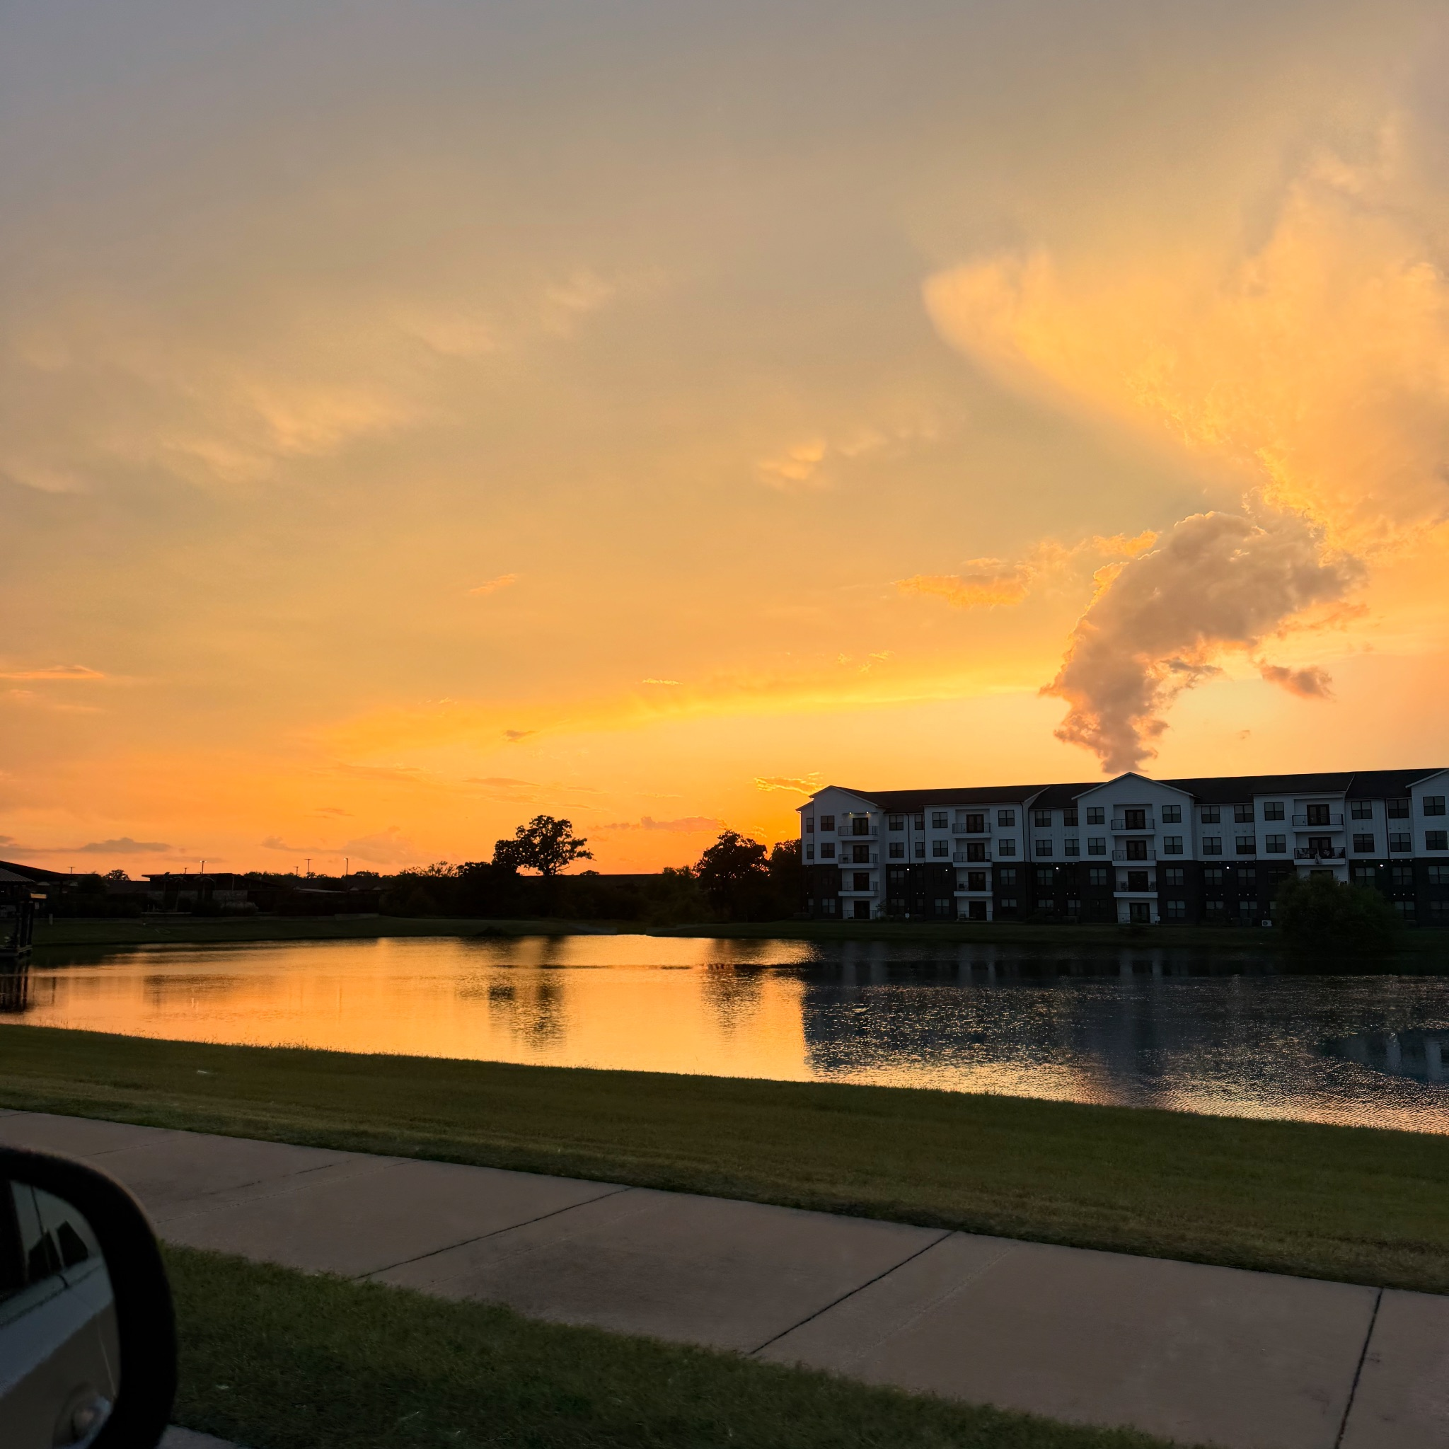
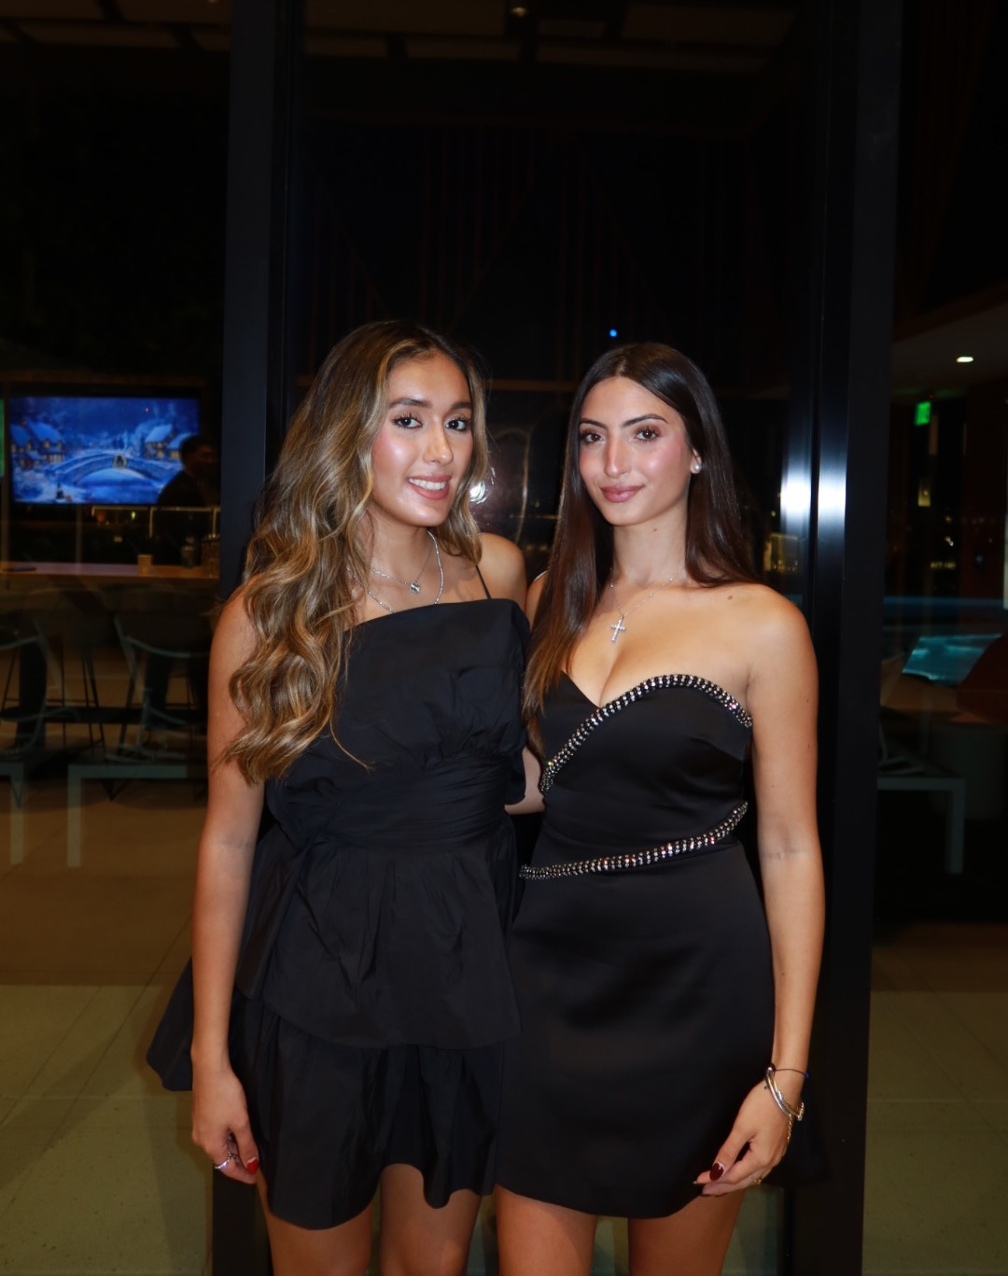
Director of Public Relations - Alexandra Ganim
Major: Business Management Pre-Law / Minor in Psychology
Hometown: Houston, Texas
Legal Field: Personal Injury or Entertainment Law
Interesting Facts:
  I love pilates and going on long walks
  I love travelling
  I love taking photos of sunsets

Slide 16
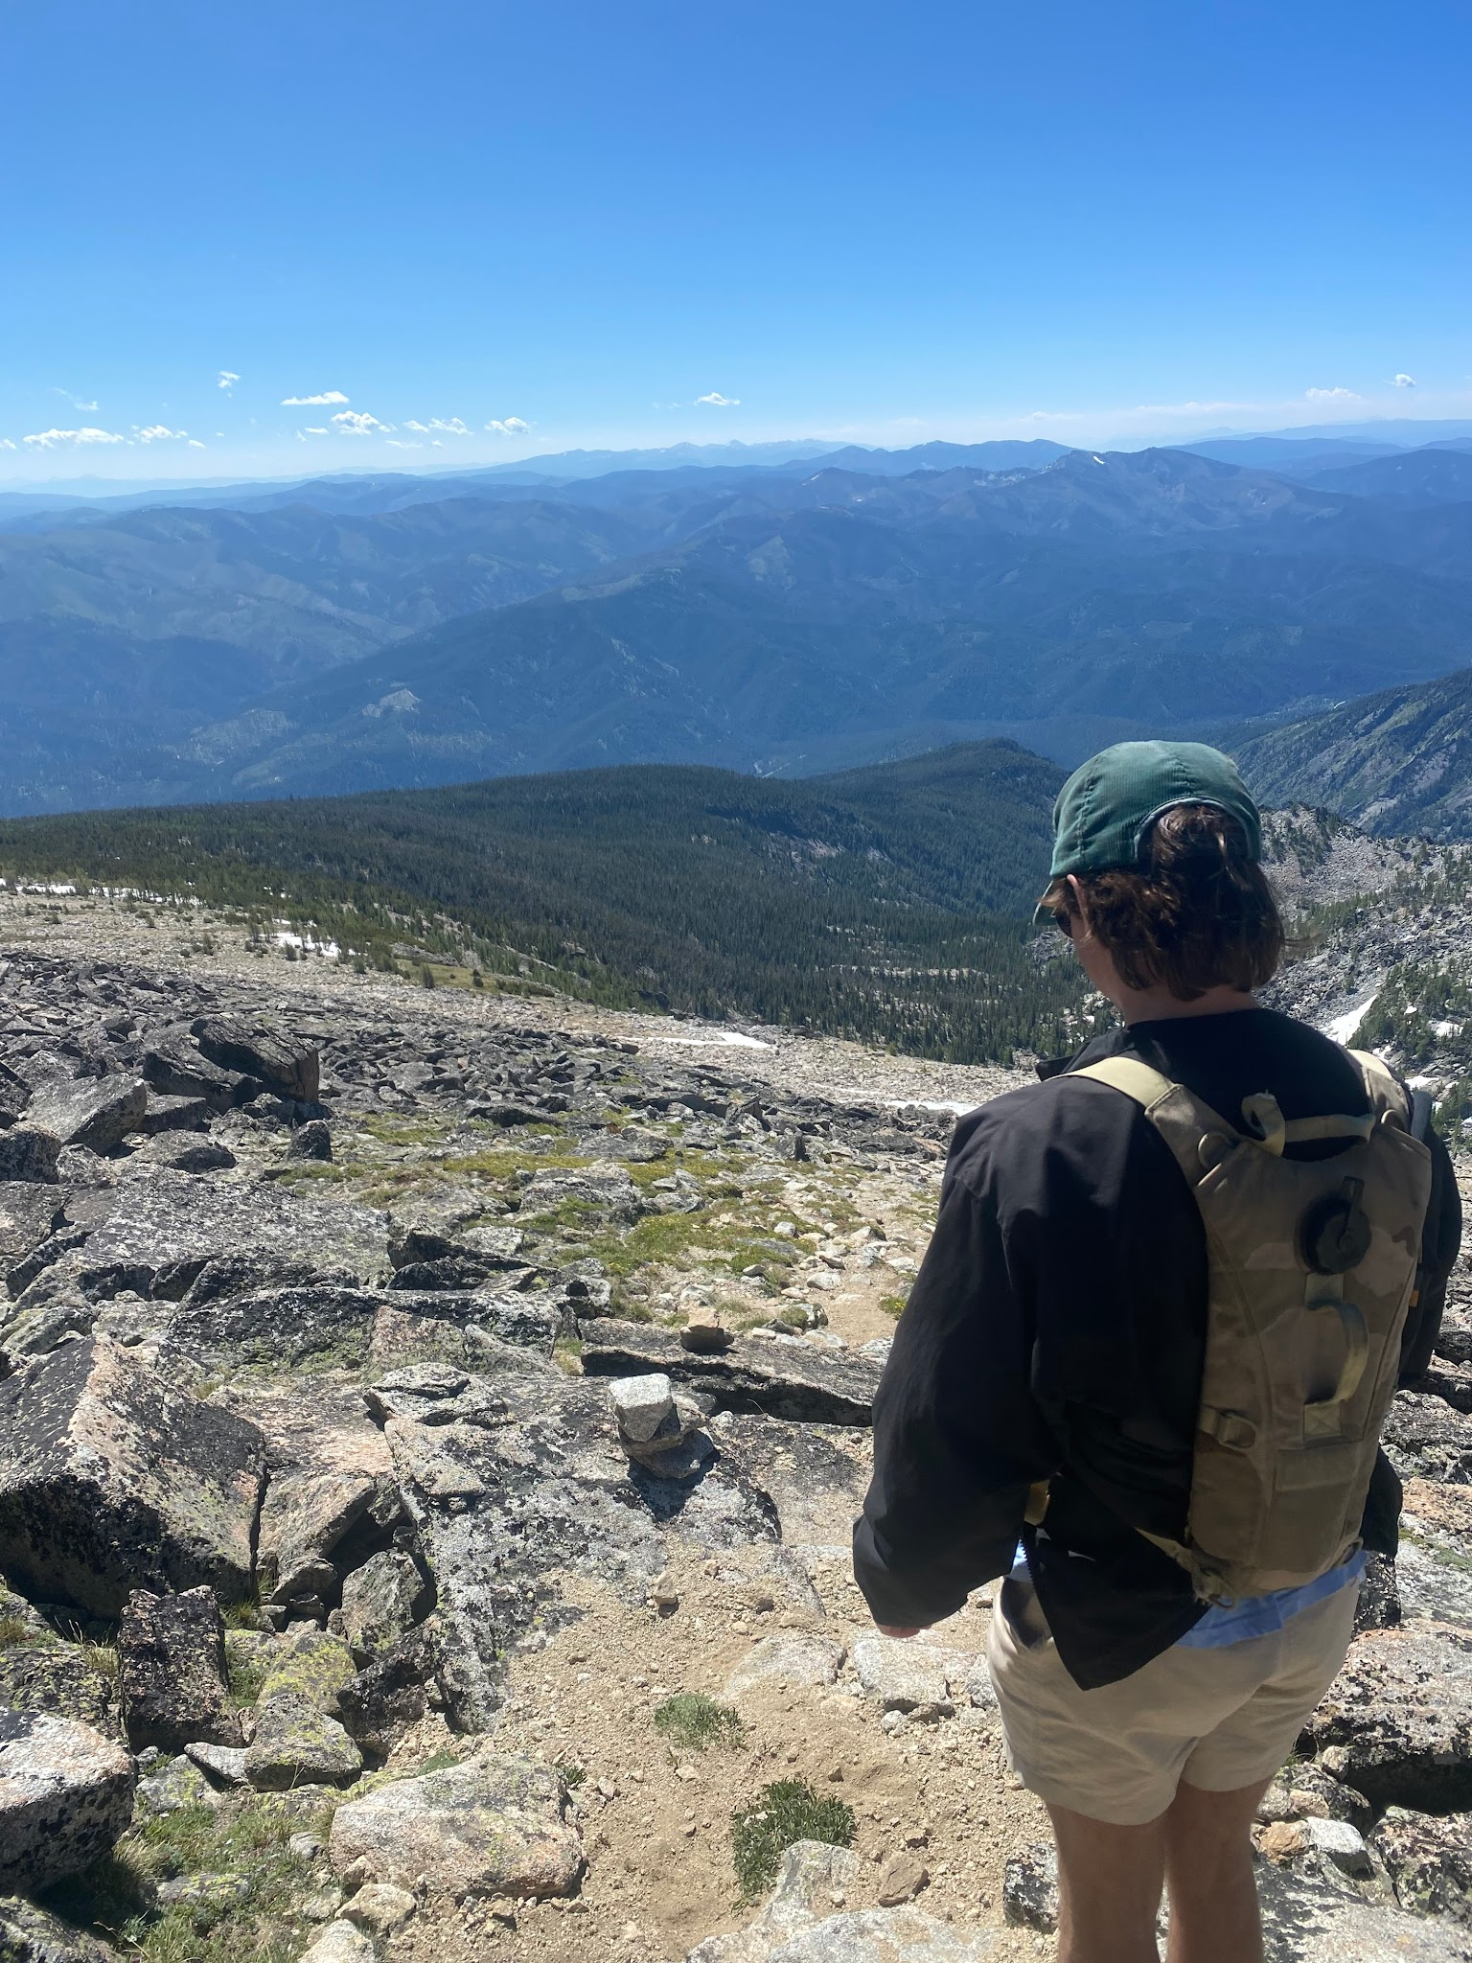
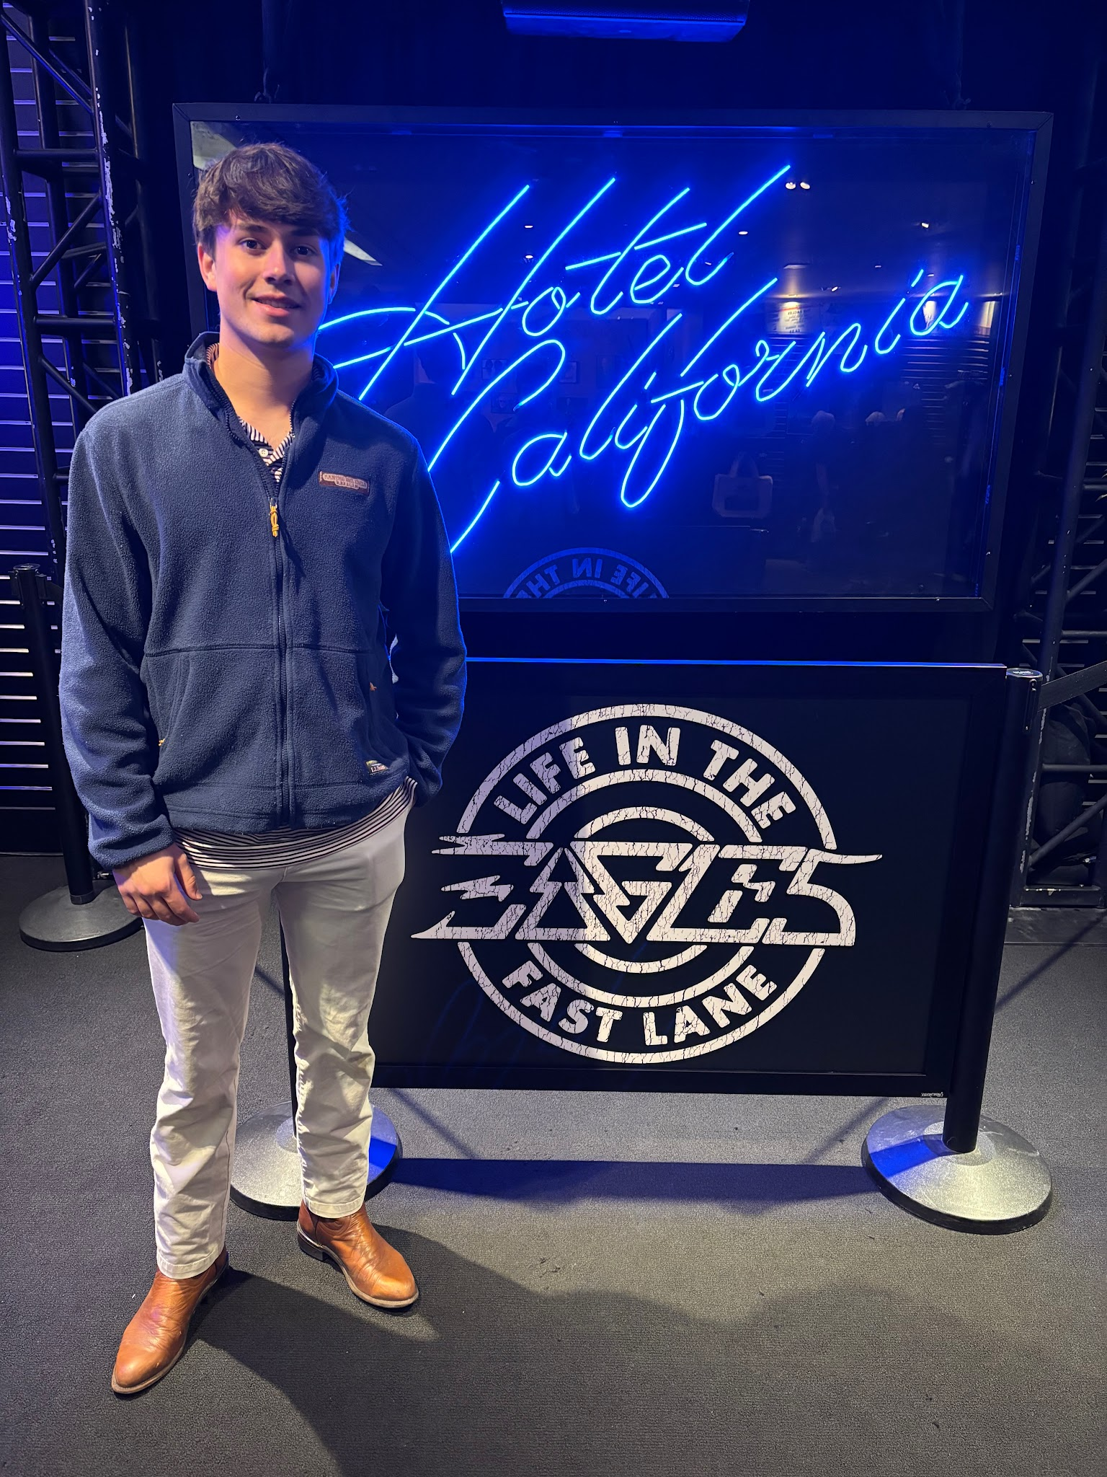
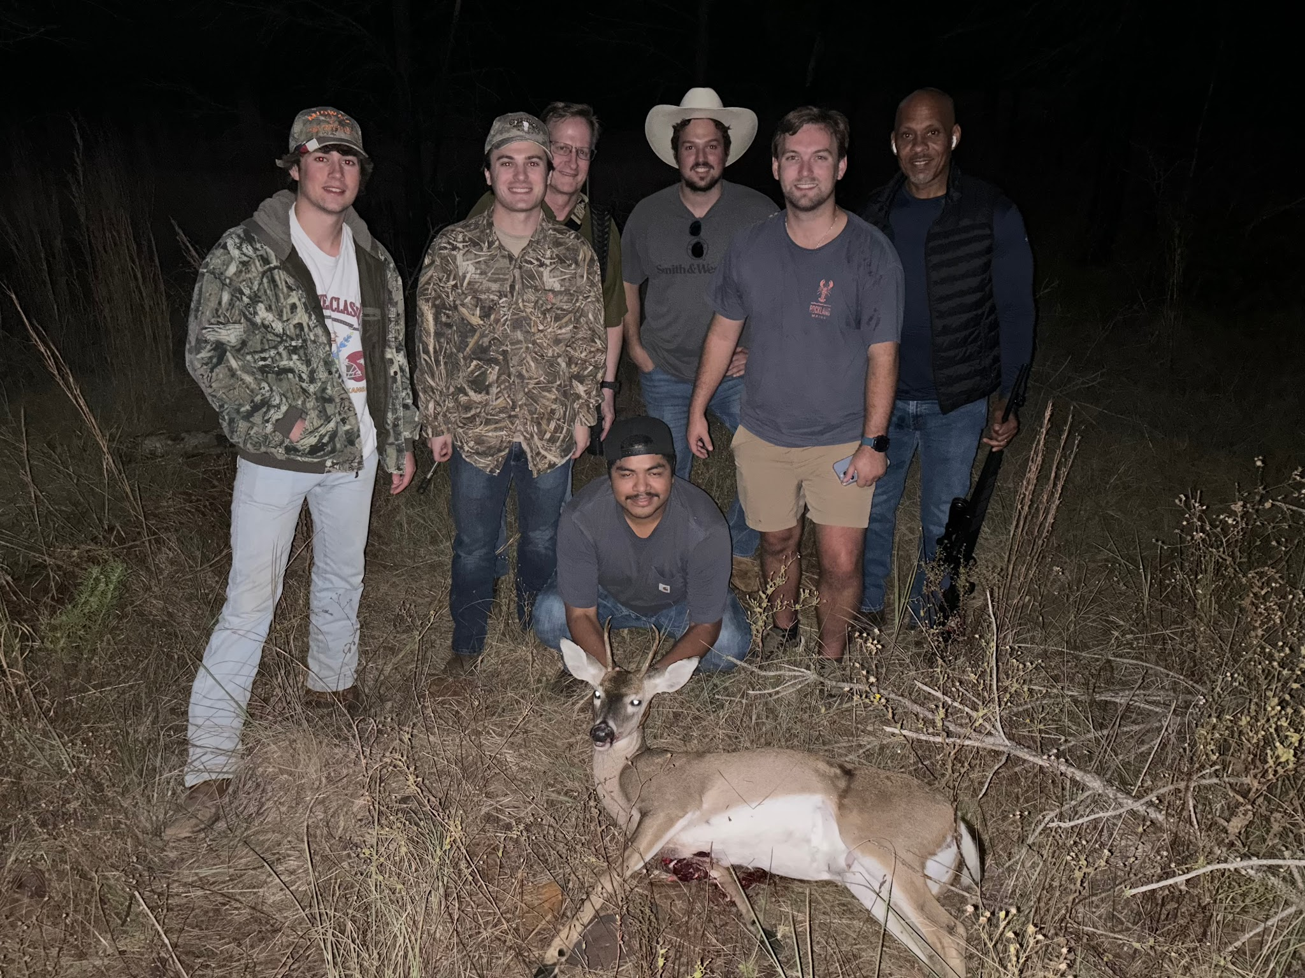
Director of Recruitment- Lucas Vaughan ‘27
Major: Bachelor of Arts in Economics
Hometown: Houston, Texas
Legal Field: Corporate Law
Interesting Facts:
  Enjoy deer hunting at ranch in Bastrop and spending time in the outdoors
  Big basketball enthusiast
  Huge classic rock fan (especially the Eagles)
  Love to travel the world

Slide 17
What is the purpose of the Pre-Law Society?
To serve as a resource for students interested in legal studies or profession
A contact point for law schools, attorneys, LSAT Prep Companies, and others in the legal field
To foster fellowship between pre-law students
Notes:
James

Slide 18
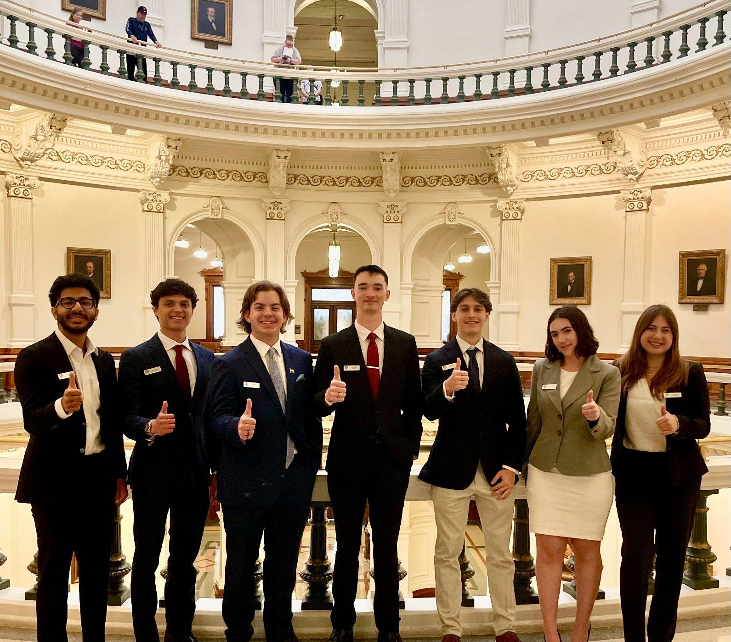
How do you benefit?
10-12 meetings with Law School admissions staff, directors, deans, or practicing attorneys in a variety of fields.
10-12 social/service opportunities to give back and build community.
Up to thousands of dollars off of some of the top LSAT preparation courses. (The Princeton Review, Kaplan, LSAT Demon).
The Pre-Law Society Scholarship Program, awarding thousands of dollars to outstanding members every semester.
All expenses paid trip opportunities to places such as the Capital of Texas and Law Schools.
First access to many local firms and law offices attempts to recruit legal interns.
Leadership opportunities: committees, officer applications this Fall!
A network of highly motivated Aggies with an interest in law.
The opportunity to participate in our BRIDGE program and make connections
Notes:
James

Slide 19
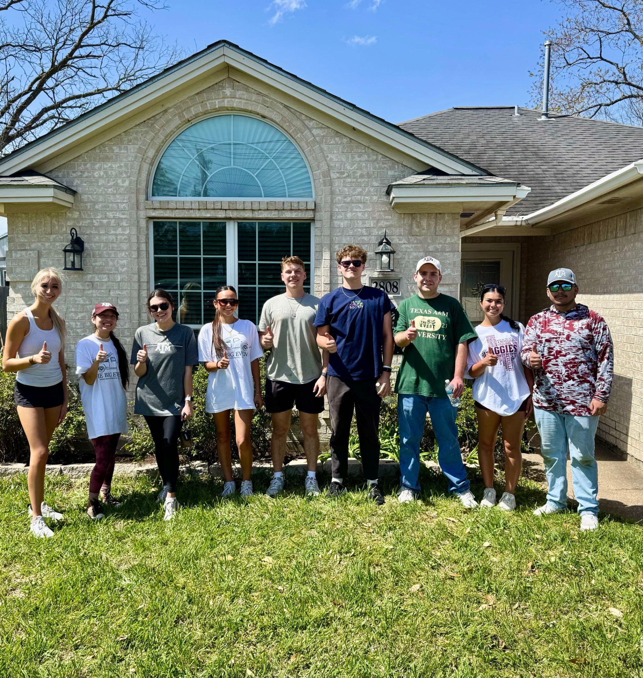
Membership
Open to any student in good standing with the University
  Applications close 9/13/26
  Find on Instagram & PLS Website
Membership Dues Required
  $50/semester or $80/year. Pay on Flywire (once link is sent out)
  Access to all meetings, socials, service events, & LSAT Prep discounts
Email List/Flare
  Main methods of communication, only paying members
Notes:
James

Slide 20
How to get involved?
Notes:
Thomas

Slide 21
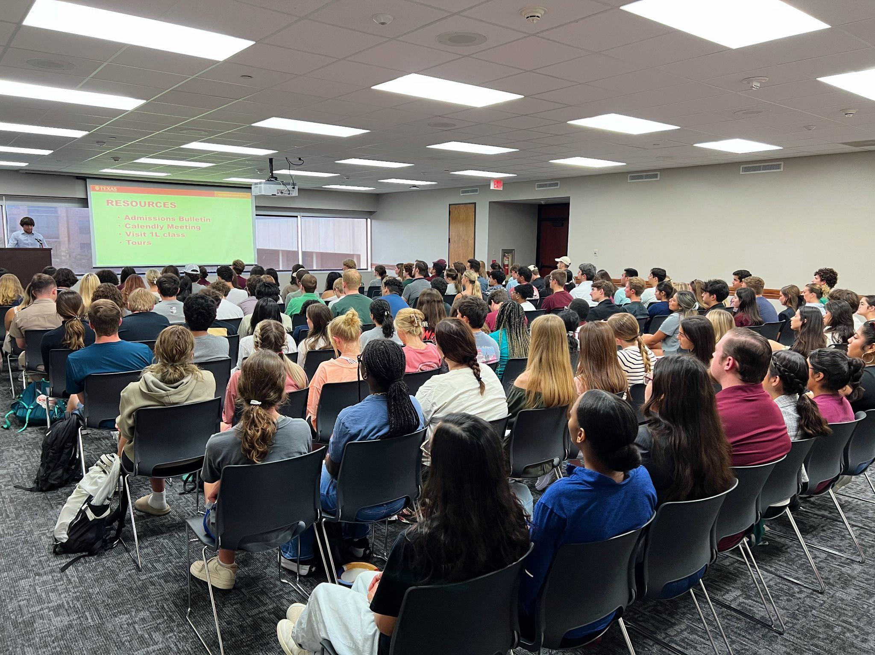
Meetings
Semi-Weekly meetings; alternating W/Th @ 5:30pm
Meetings are closed to paid members only
  Membership dues deadline 9/22
Focus
  Fall: Law School Admissions, LSAT Prep
  Spring: Legal profession, LSAT prep, & Professional Development
Notes:
Thomas

Slide 22
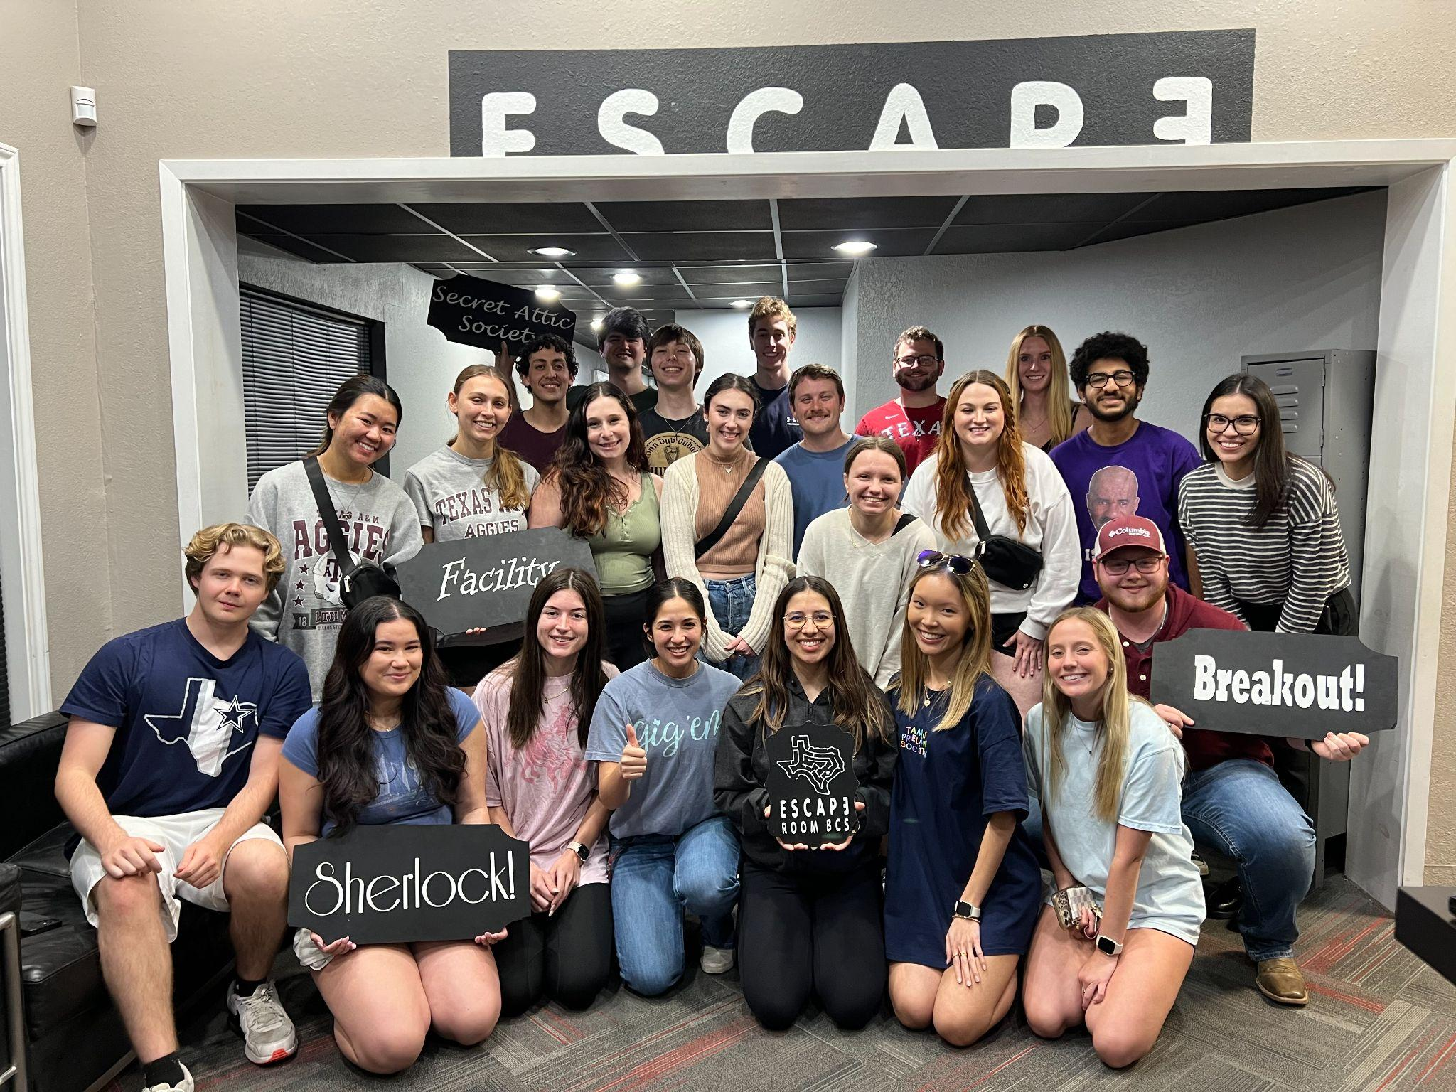
Events
Socials
Speakers/Panels
Mock Law Classes
Mock LSATs
Networking/Mentoring
Resume Workshops
Notes:
Thomas

Slide 23
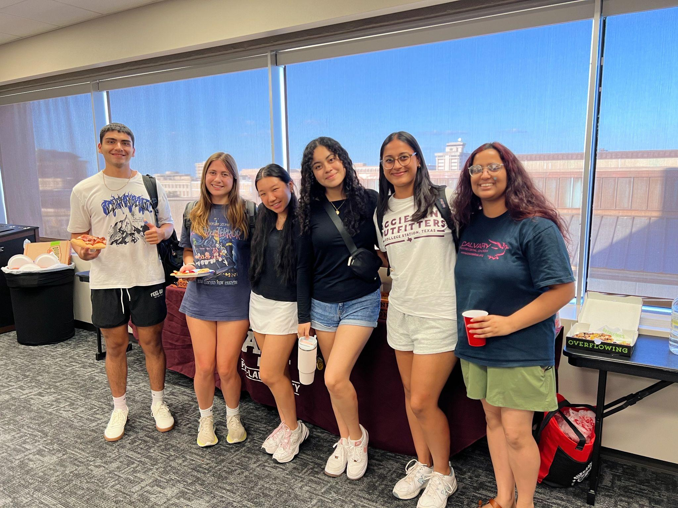
Good Standing Requirements
General Meetings
  Two meetings per semester
Social and Service Events
  Two events per semester (either or)
Pay dues
  After applying you will receive more info
Notes:
Grayson

Slide 24
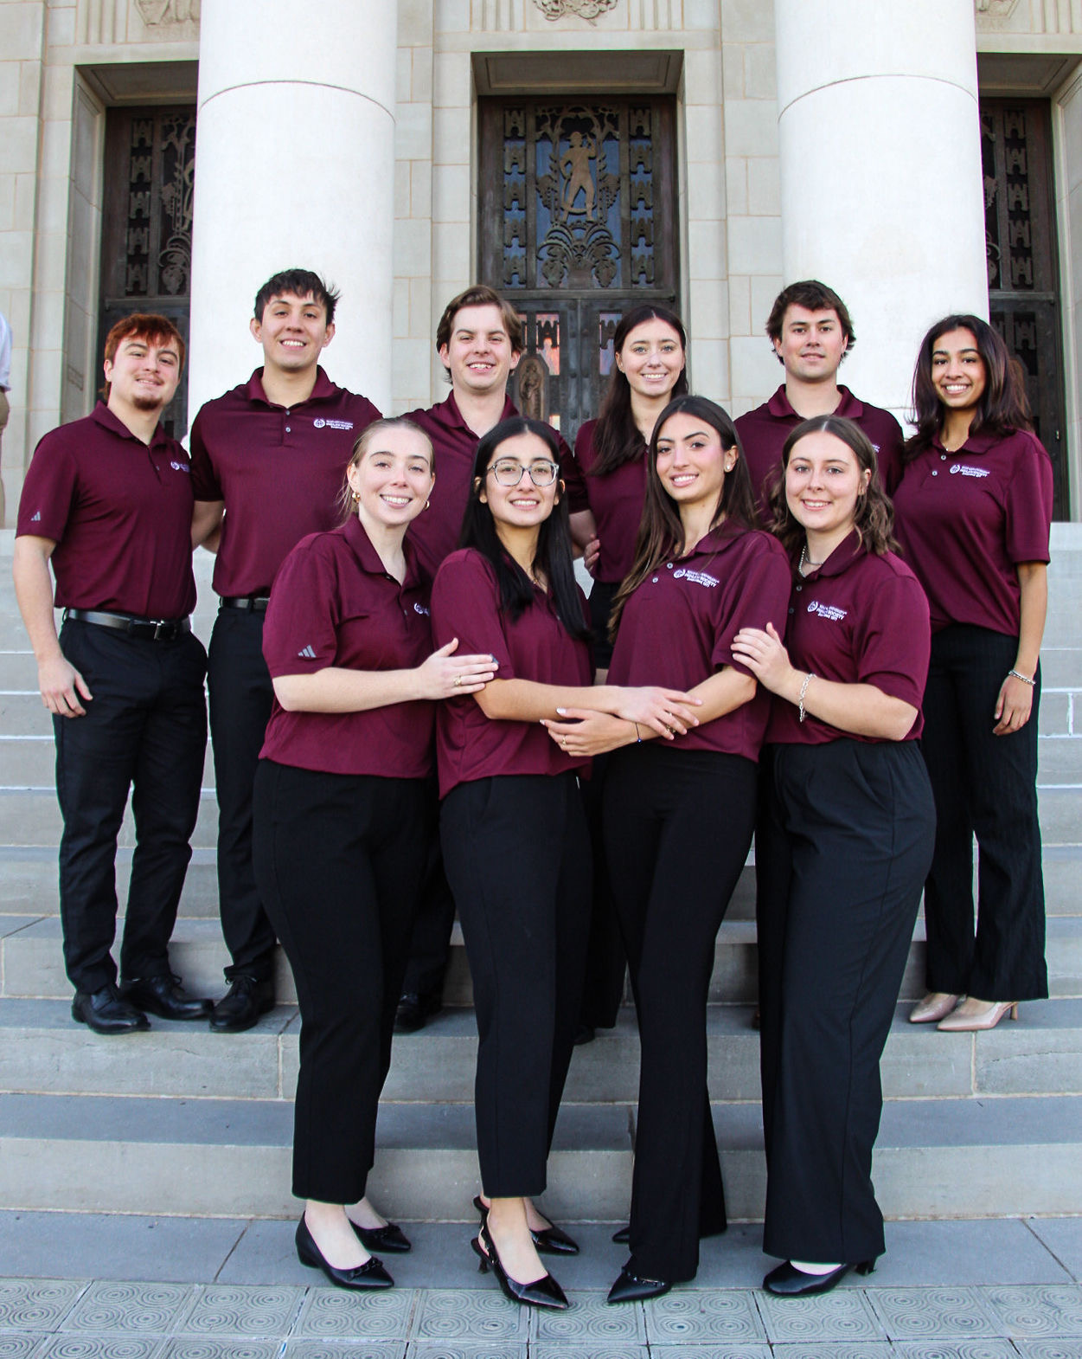
Officer Roles
Terms are based on the calendar year (Jan-Dec)
Appointment Process
  Applications open this November
Requirements/Considerations:
  Membership length
  Attendance
  Graduation Date
Notes:
Grayson
Officers will serve from January 1st to December 31st, this means that officers should be graduating at least a year after their appointment. This means those officers appointed this fall must graduate December 2025 or later. We will provide more information on the applications regarding requirements to be an officer, but we will let everyone know now that we will be taking in consideration the attendance and commitment of members seeking to be an officer.

Slide 25

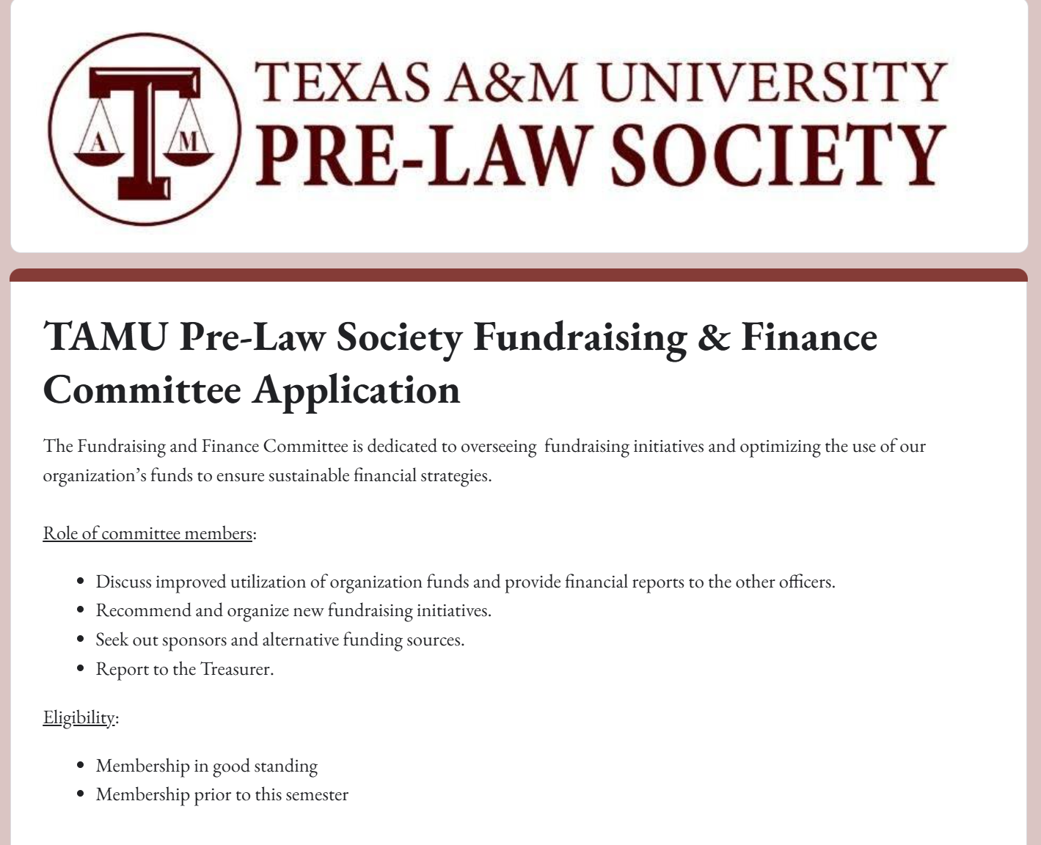
Fundraising and Finance Committee
Must be a member for at least one semester to be eligible
Responsibilities
Identify and organize new fundraising opportunities
Seek sponsorships and alternative funding sources
Analyze and propose strategies for more effective fund utilization; assist with budget process
Structure
Chair: Treasurer, ensuring financial oversight
Application Process: Submit a resume, and answer a few short questions
Meetings: Held twice per month

Slide 26
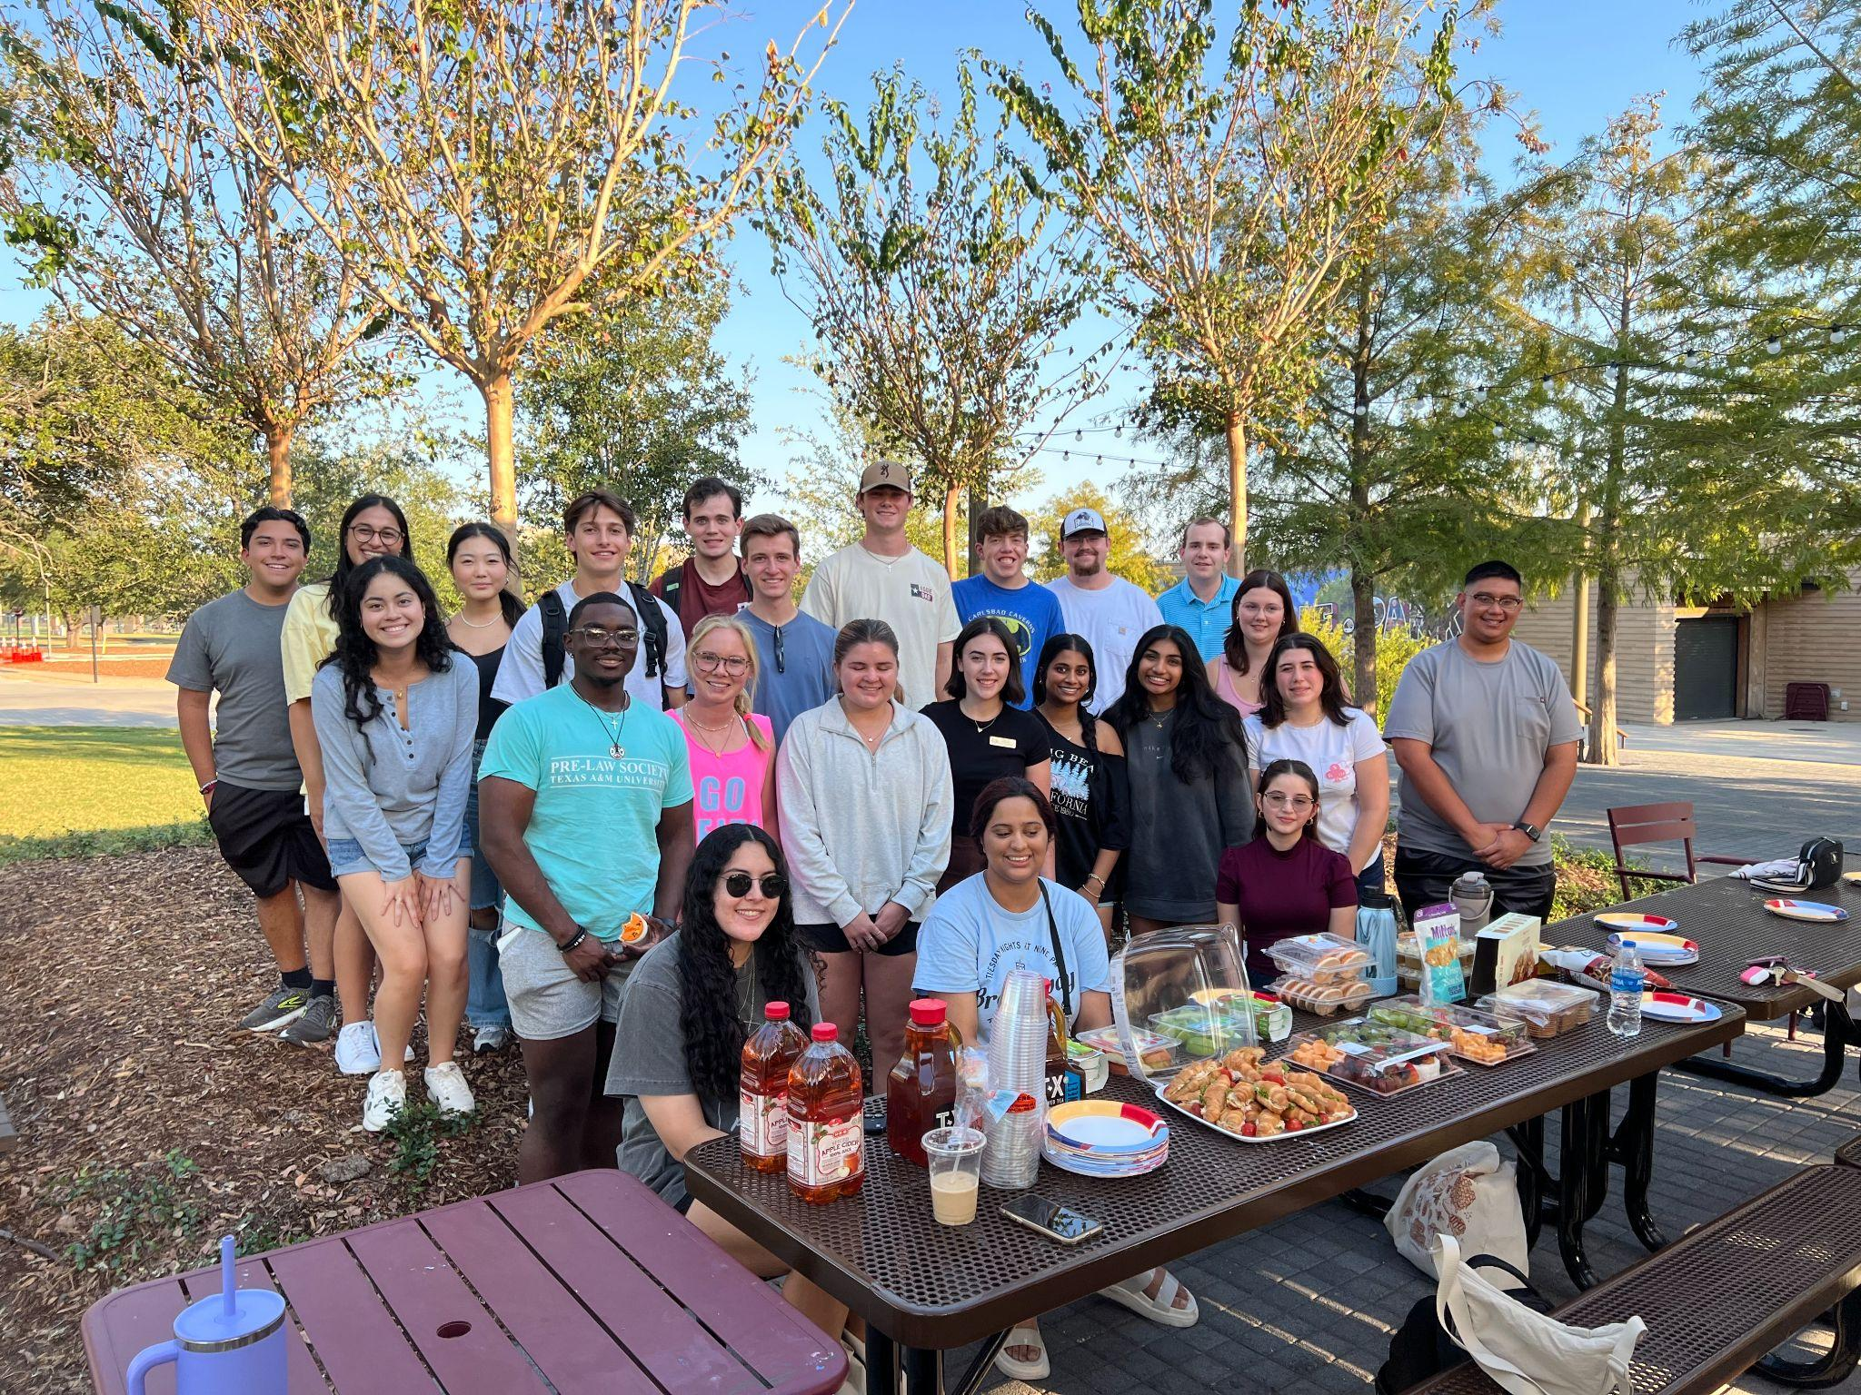
Social & Service Committee
Social & Service
  Event Planning & Management
  Organizing Philanthropy Events
  Fundraising For Charity
  Semester Terms
In order to apply, you must be a
member in good standing!
Notes:
Taylor

Slide 27


Public Relations Committee
Public Relations
  Help with disbursement of merchandise
  Aid in the timely advertisement of organizational events
Must be current member to apply
Notes:
Taylor

Slide 28
Upcoming Events
Sweet Eugene’s Profit Share. 9/8, 2-7 pm
  This is a fundraiser for the Pre-Law Society, this will count as a social point.
  From 5-7 pm there will be a tab for attendees to purchase drinks, first come first serve, officers will be there at this time as well
TAMU Law, 9/9, 5:30 pm, RT 601
  Everyone is welcome to attend (member or not)
  Member Applications will close on the following Sunday (9/13)
Notes:
Taylor

Slide 29
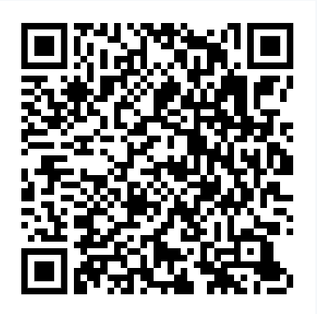
Membership Application
You can also apply on our website!
www.tamuprelaw.com
Notes:
James (wrap it up)

Slide 30
Thank you!
Applications close 9/13
Notes:
James

